Slide 2
Learning what it means to be a disciple of Jesus

Slide 3
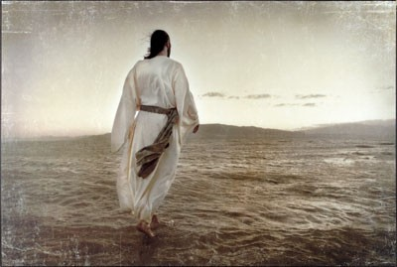
COME FOLLOW ME Learning what it means to be a disciple of Jesus

Slide 4
COME FOLLOW ME Learning what it means to be a disciple of Jesus
A dis●ci●ple: A follower
How do I become a Disciple? It starts at your salvation.
A Disciple of Jesus is disciplined.

Slide 5
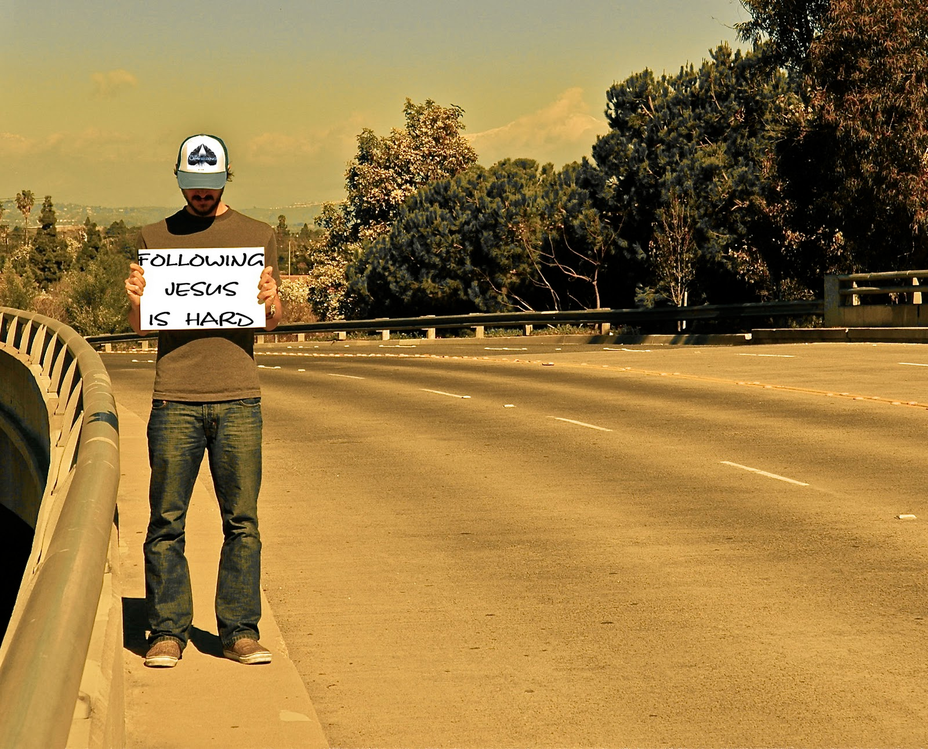
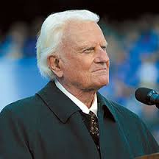
"Salvation is free, but discipleship costs everything we have.”
Billy Graham
“It is only because he became like us that we can become like him.”
― Dietrich Bonhoeffer, The Cost of Discipleship

Slide 6
COME FOLLOW ME Learning what it means to be a disciple of Jesus
Today’s Sermon: A Picture of a Disciple
A Disciple…
Read II Timothy 2:14-15
works hard
to study the Word.
to “handle” the Word.

Slide 7
COME FOLLOW ME Learning what it means to be a disciple of Jesus
Today’s Sermon: A Picture of a Disciple
A Disciple…
2. Read II Timothy 2:16-19
Avoids “godless chatter” which …
Is a departure from the truth.
Spreads like gangrene.
Destroys the faith of others.

Slide 8
COME FOLLOW ME Learning what it means to be a disciple of Jesus
Today’s Sermon: A Picture of a Disciple
A Disciple…
3. Read II Timothy 2:20-26
Is set apart to…
flee evil desires.
pursue righteousness.
Instruct opponents.

Slide 9
COME FOLLOW ME Learning what it means to be a disciple of Jesus

