Slide 1
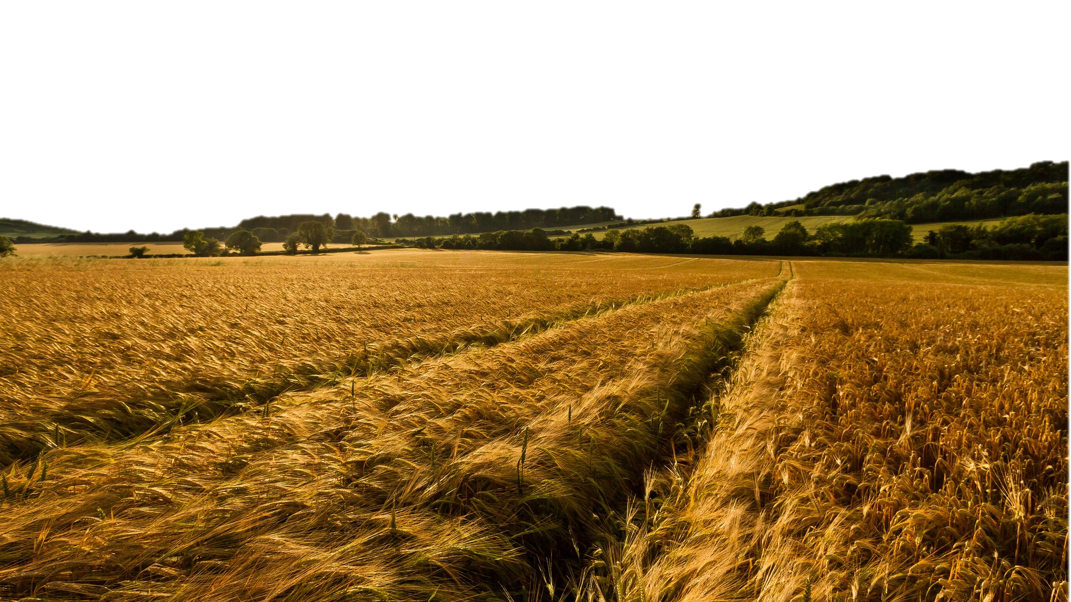
The Harvest Strategy- How we fulfill our purpose!
We Love the Lost
Part 6 in “The Harvest Strategy” Series

Slide 2
The Harvest Strategy- How we fulfill our purpose!
We Love the Lost
Part 6 in “The Harvest Strategy” Series
Luke 15
Loving the Lost means I need:
1. __________________________________.
Psalm 103:8-10 “The Lord is compassionate and gracious, slow to anger and abounding in loving-kindness. He will not always strive with us; nor will He keep His anger forever. He has not dealt with us according to our sins, nor rewarded us according to our iniquities.”
THE COMPASSION OF THE FATHER

Slide 3
The Harvest Strategy- How we fulfill our purpose!
We Love the Lost
Part 6 in “The Harvest Strategy” Series
Luke 15
Loving the Lost means I need:
2. ____________________________.
2 Peter 3:9 “The Lord is not slow about His promise, as some count slowness, but is patient toward you, not wishing for any to perish but for all to come to repentance.”
THE HEART OF THE FATHER

Slide 4
The Harvest Strategy- How we fulfill our purpose!
We Love the Lost
Part 6 in “The Harvest Strategy” Series
Luke 15
Loving the Lost means I need:
3. ______________________.
Luke 15:6 “…Rejoice with me, for I have found my sheep which was lost!”
I Thessalonians 2:19-20 “For what is it we live for that gives us hope and joy and is our proud reward and crown ? It Is you! Yes, you will bring us much joy as we stand together before our Lord Jesus Christ when He comes back again. For you are our glory and joy.”
THE JOY OF THE FATHER

Slide 5
The Harvest Strategy- How we fulfill our purpose!
We Love the Lost
Part 6 in “The Harvest Strategy” Series
Luke 15
Loving the Lost means I need:
__________________________.
Proverbs 11:30 “The fruit of the righteous is a tree of life, and he who is wise wins souls.”
THE WISDOM OF THE FATHER

Slide 6
The Harvest Strategy- How we fulfill our purpose!
We Love the Lost
Part 6 in “The Harvest Strategy” Series
“Being salt and light demands two things: we practice purity in the midst of a fallen world and yet we live in proximity to this fallen world. If you don’t hold up both truths in tension, you invariably become useless and separated from the world God loves. For example, if you only practice purity apart from proximity to the culture, you inevitably become pietistic, separatist, and conceited. If you live in close proximity to the culture without also living in a holy manner, you become indistinguishable from fallen culture and useless in God’s kingdom.”
Mike Metzger
Fine Tuning Tensions Within Culture: The Art of Being Salt and Light

