Slide 1
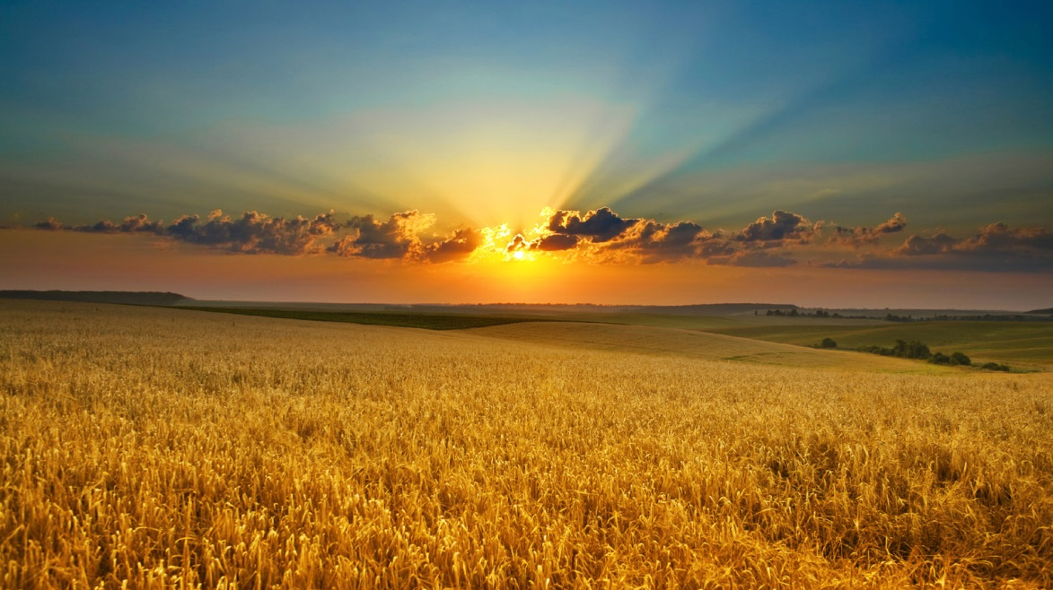
The Harvest
Strategy
Then he said to his disciples, "The harvest is plentiful, but the laborers are few, therefore pray earnestly to the Lord of the harvest to send out laborers into his harvest." Matthew 9:37-38

Slide 2
The Harvest
Strategy
Then he said to his disciples, "The harvest is plentiful, but the laborers are few, therefore pray earnestly to the Lord of the harvest to send out laborers into his harvest." Matthew 9:37-38
Our BELIEFS define Who we are as a Church.
The Creation of the Universe by God.
The Infallibility and Inerrancy of the 66 Books of the Bible.
The Doctrine of the Trinity.
The Virgin Birth and Deity of Christ.
Salvation by faith alone, grace alone, and by Christ alone.
The Second Coming of Christ.
The Eternal existence of Heaven and Hell.

Slide 3
The Harvest
Strategy
Then he said to his disciples, "The harvest is plentiful, but the laborers are few, therefore pray earnestly to the Lord of the harvest to send out laborers into his harvest." Matthew 9:37-38
Our BELIEFS define Who we are as a Church.
Our STRATEGY defines our Purpose as a Church.
The Harvest Strategy starts with…
The Great Commandment: “Jesus said, ‘Love the Lord your God with all your heart...soul...and mind. This is the first and greatest commandment. And the second is like it: Love your neighbor as yourself. All the Law and Prophets hang on these two commandments.’” Matt. 22:36-40

Slide 4
The Harvest
Strategy
Then he said to his disciples, "The harvest is plentiful, but the laborers are few, therefore pray earnestly to the Lord of the harvest to send out laborers into his harvest." Matthew 9:37-38
The Harvest Strategy starts with…
LOVE the Lord your God (The 1st & Greatest Commandment) READ Deuteronomy 6:4-9
Because He is Worthy. This is where the word WORSHIP comes from. Worship is not a means to an end but is the end!
Because He First loved us.

Slide 5
The Harvest
Strategy
Then he said to his disciples, "The harvest is plentiful, but the laborers are few, therefore pray earnestly to the Lord of the harvest to send out laborers into his harvest." Matthew 9:37-38
The Harvest Strategy starts with…
2. Love your neighbor (The 2nd Commandment)
READ Leviticus 19:18
Its Always BEEN the strategy.
READ Matthew 7:12
Its the best way to Summarize the Bible.
READ I Corinthians 13:1-8.
It is the only way to have a Believable Ministry (Ministry = Loving People).

Slide 6
The Harvest
Strategy
Congregational Meeting
Tonight at 5:30PM

