Slide 2
Learning what it means to be a disciple of Jesus

Slide 3
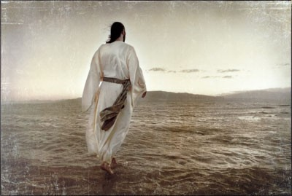
COME FOLLOW ME Learning what it means to be a disciple of Jesus

Slide 4
COME FOLLOW ME Learning what it means to be a disciple of Jesus
A dis●ci●ple: A follower
How do I become a Disciple? It starts at your salvation.
A Disciple of Jesus is disciplined.

Slide 5
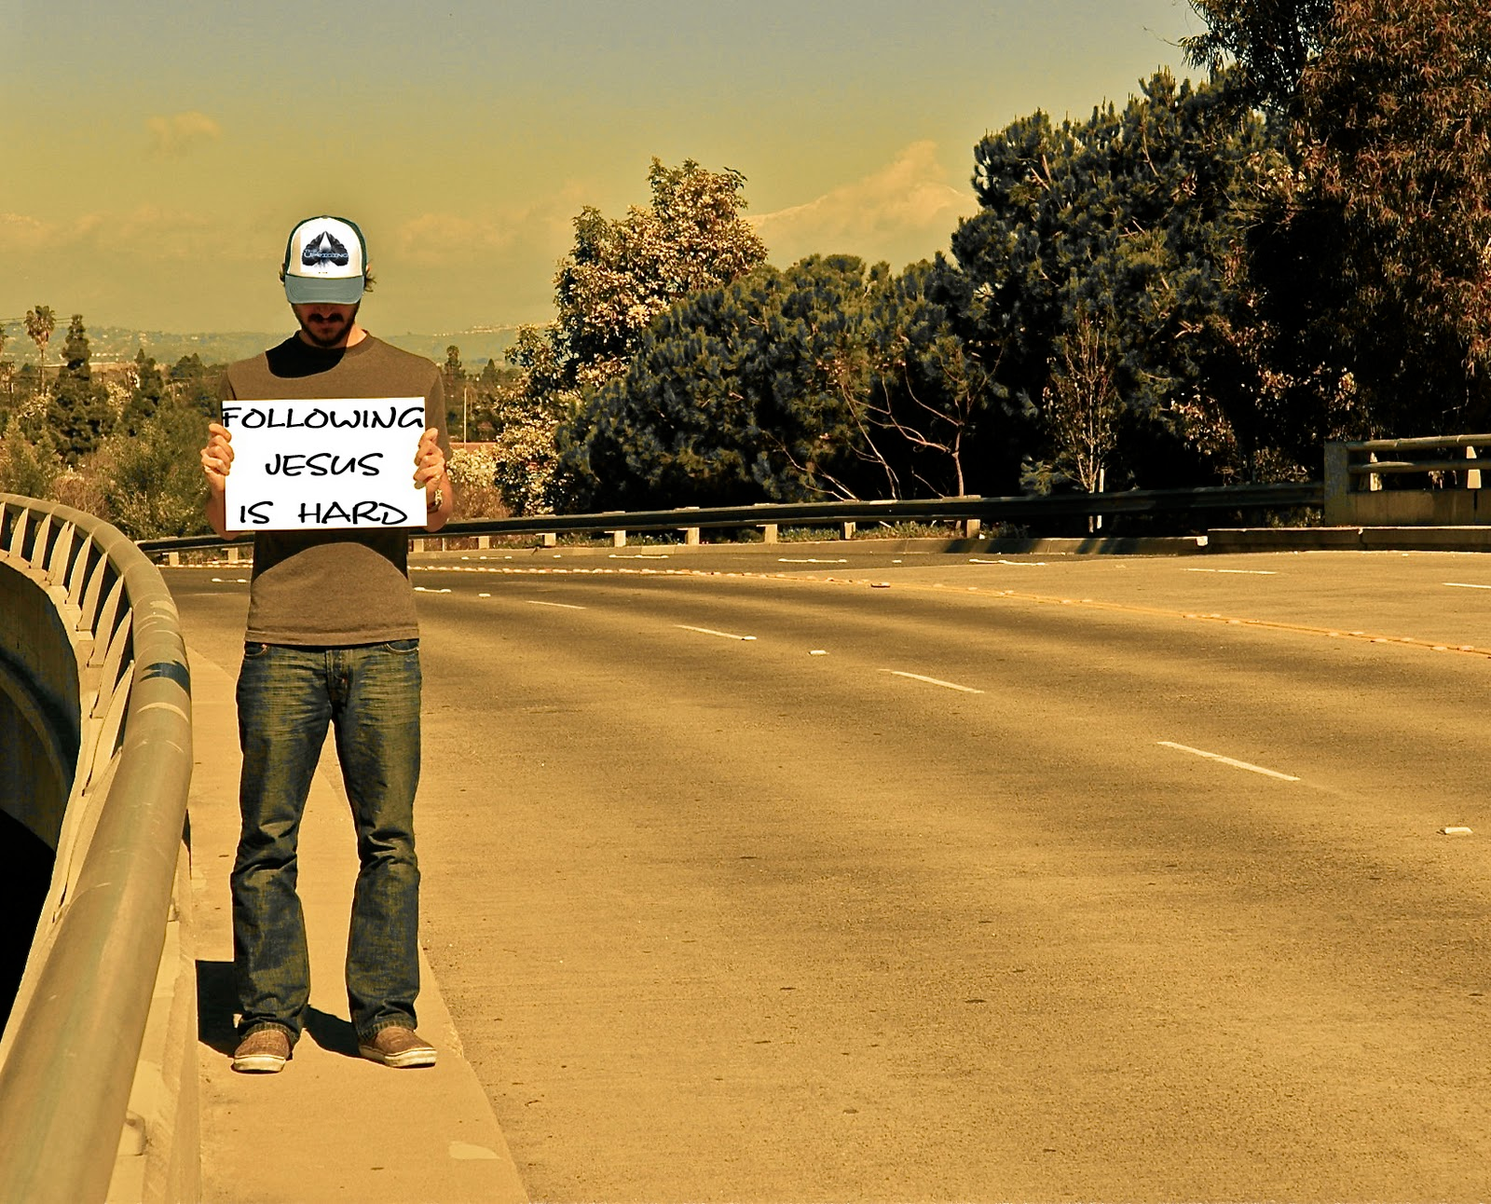
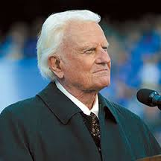
"Salvation is free, but discipleship costs everything we have.”
Billy Graham
“It is only because he became like us that we can become like him.”
― Dietrich Bonhoeffer, The Cost of Discipleship

Slide 6
COME FOLLOW ME Learning what it means to be a disciple of Jesus
A Disciple…
II Timothy 3:1-7
Is not influenced by the Lifestyles of last days people.

Slide 7
COME FOLLOW ME Learning what it means to be a disciple of Jesus
A Disciple…
II Timothy 3:8-9
Is not fooled by the false teachings of last days people.
Also SEE Matthew 7:13-20.

Slide 8
COME FOLLOW ME Learning what it means to be a disciple of Jesus
A Disciple…
II Timothy 3:10-13
Is not defeated by the persecution of last days people

Slide 9
COME FOLLOW ME Learning what it means to be a disciple of Jesus
A Disciple…
II Timothy 3:14-17
Is equipped by continuing in God’s Word that lasts forever.

Slide 10
COME FOLLOW ME Learning what it means to be a disciple of Jesus

