Slide 2
Learning what it means to be a disciple of Jesus

Slide 3
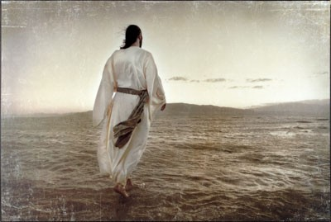
COME FOLLOW ME Learning what it means to be a disciple of Jesus

Slide 4
COME FOLLOW ME Learning what it means to be a disciple of Jesus
A dis●ci●ple: A follower
How do I become a Disciple? It starts at your salvation.
A Disciple of Jesus is disciplined.

Slide 5
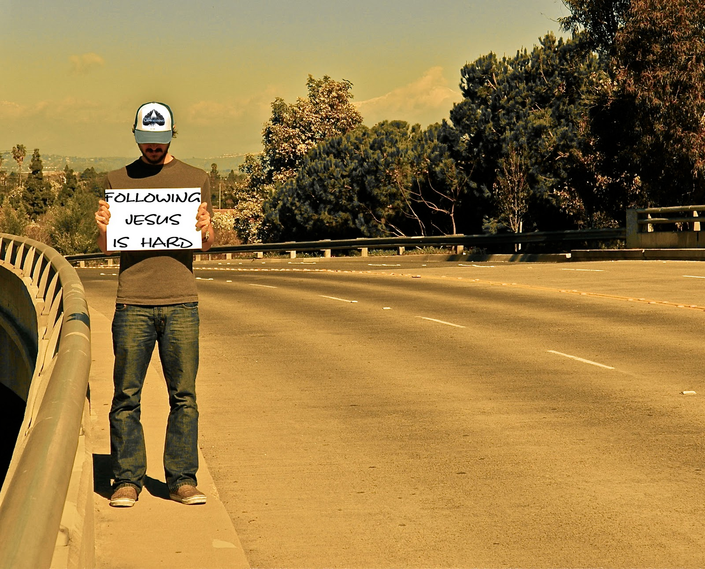
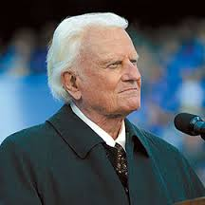
"Salvation is free, but discipleship costs everything we have.”
Billy Graham

Slide 6
COME FOLLOW ME Learning what it means to be a disciple of Jesus
A Disciple…
1. Read II Timothy 2:1,2a
Is like a copycat; imitating a strong Christian.
2. Read II Timothy 2:2b
Is like a copy machine; making disciples of others.

Slide 7
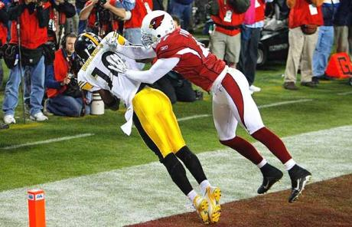
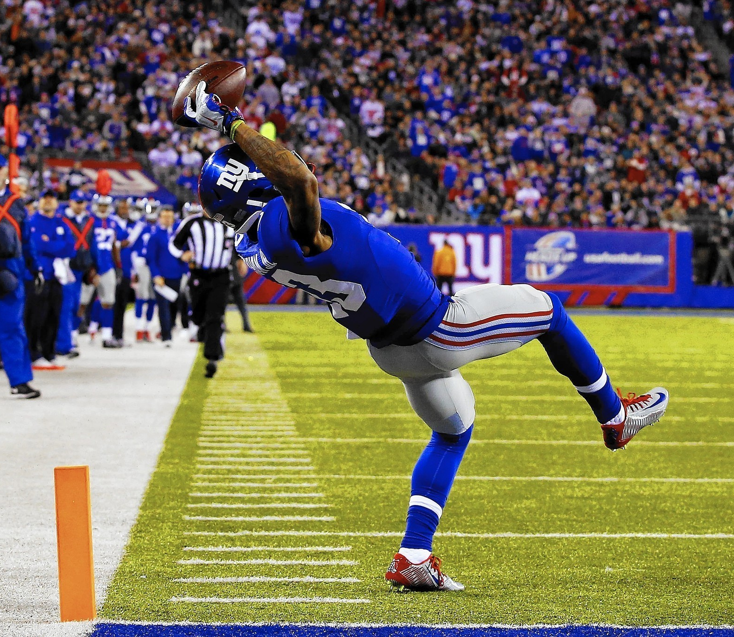
COME FOLLOW ME Learning what it means to be a disciple of Jesus
A Disciple…
3. Read II Timothy 2:3-4
Is like a soldier; listening & obeying his Commander.
4. Read II Timothy 2:5
Is like an athlete; playing in bounds.
5. Read II Timothy 2:6
Is like a farmer; working hard towards a Harvest.

Slide 8
COME FOLLOW ME Learning what it means to be a disciple of Jesus
A Disciple…
6. Read II Timothy 2:7-13
Becomes like Jesus, enduring hardship.

Slide 9
COME FOLLOW ME Learning what it means to be a disciple of Jesus

