Slide 1
2
PART

Slide 2
DON’T HIDE!
Read Luke 10:25-29.
The world’s way of thinking:
My neighbors are the people living on
Our definition of our neighbor must be stretched.
GOD’S PEOPLE FINDING GOD’S HEART FOR THE WORLD
PART 2: SERVE THE LOST
either side of our house.

Slide 3
DON’T HIDE!
Read Luke 10:30-32.
The Priest and the Levite’s way of thinking:
“My agenda, and schedule are more important than .”
I am going out of my way to not do the right thing. (“…other side of the road.”)
“The Harvest is plenty and the workers are few…” but are they (by choice)
GOD’S PEOPLE FINDING GOD’S HEART FOR THE WORLD
PART 2: SERVE THE LOST
people
BLIND, or HIDING?

Slide 4
DON’T HIDE!
Read Luke 10:33.
The Samaritan’s way of thinking:
I will open my eyes to notice the of others.
I will and help.
I will care because compassion makes for others.
GOD’S PEOPLE FINDING GOD’S HEART FOR THE WORLD
PART 2: SERVE THE LOST
needs
stop
time

Slide 5
DON’T HIDE!
Read Luke 10:33.
The Samaritan’s way of thinking:
My neighbor is anyone, even the person I
GOD’S PEOPLE FINDING GOD’S HEART FOR THE WORLD
PART 2: SERVE THE LOST
don’t like.

Slide 6
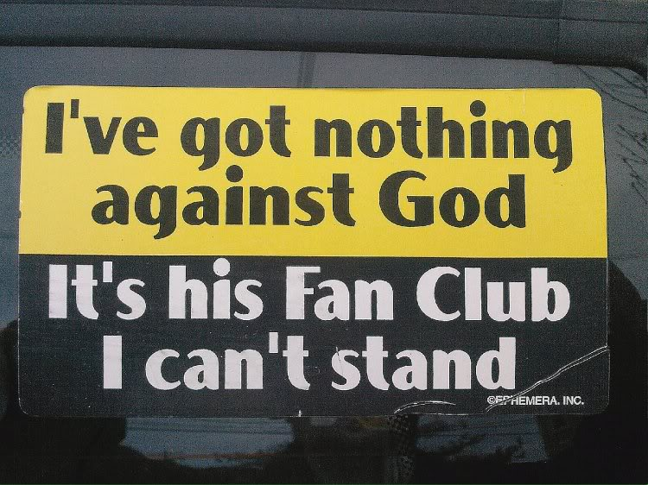
DON’T HIDE!
Read Luke 10:33.
What perspective does the world have of Christians?
GOD’S PEOPLE FINDING GOD’S HEART FOR THE WORLD
PART 2: SERVE THE LOST

Slide 7
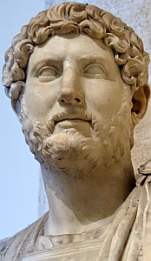
“Look at how they love one another. See how they love one another. They never fail to help the widows. They save orphans from those who would hurt them. If they have something, they give freely to those who have nothing. If they see a stranger, they take him home as though he were a brother."
Caesar Hadrian; referring to Christians during his reign (117-138 AD)
GOD’S PEOPLE FINDING GOD’S HEART FOR THE WORLD
PART 2: SERVE THE LOST

Slide 8
2
PART

Slide 10
2
PART

