Slide 1
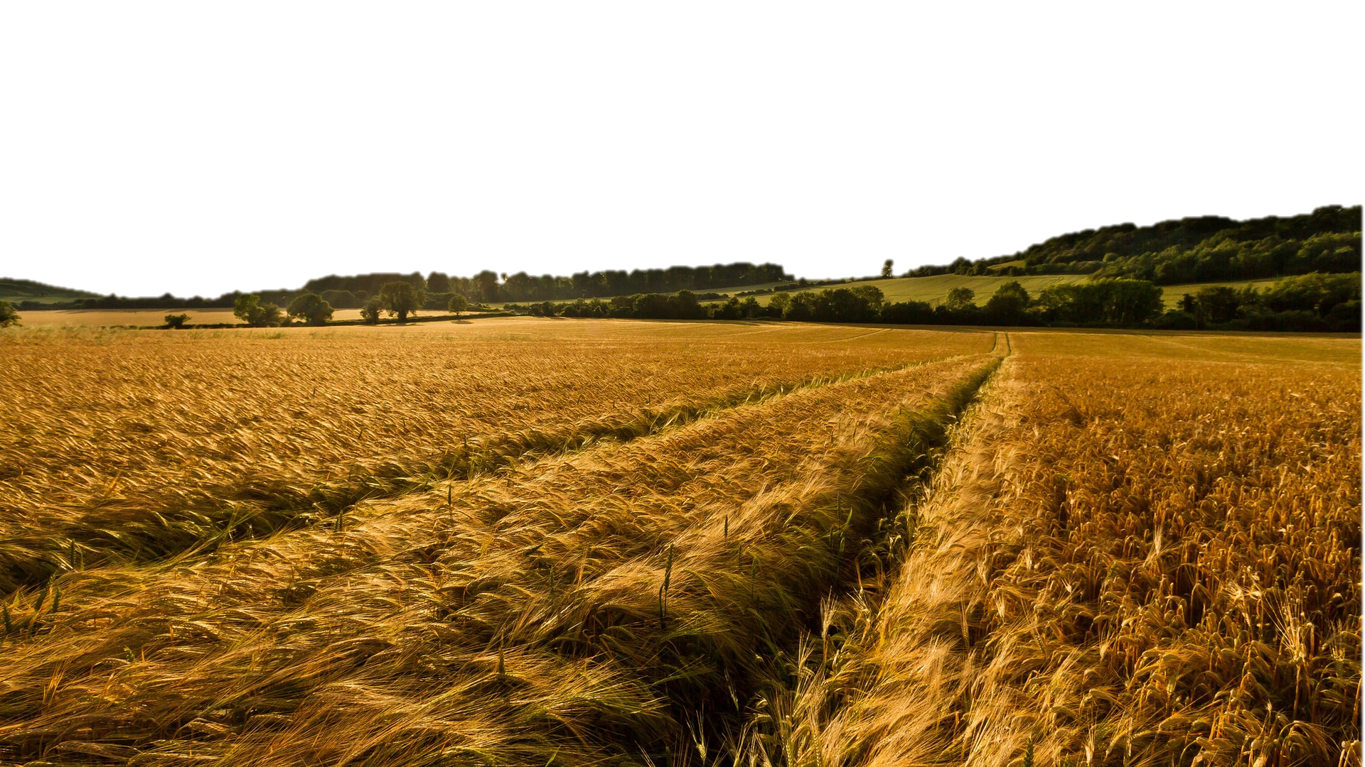
The Harvest Strategy- How we fulfill our purpose!
We are His Witnesses and His Evidence
Part 4 in “The Harvest Strategy” Series

Slide 2
The Harvest Strategy- How we fulfill our purpose!
We are His Witnesses and His Evidence
Part 4 in “The Harvest Strategy” Series
Acts 1:8 “…you shall be My witnesses both in Jerusalem, and in all Judea and Samaria, and even to the remotest part of the earth.”

Slide 3
The Harvest Strategy- How we fulfill our purpose!
We are His Witnesses and His Evidence
Part 4 in “The Harvest Strategy” Series
1. We provide a DAILY WITNESS.
Acts 5:42 “And every day, in the temple and from house to house, they kept right on teaching and preaching Jesus as the Christ.”

Slide 4
Acts 5:12-42
Witnessing without fear involves:
________________ (v.12-16)
________________ (v.17-18)
________________ (v.19-20)
________________ (v.21-33)
________________ (v.34-39)
________________ (v.40)
________________ (v.41)
________________ (v.42)
I Corinthians 9:16 “For if I preach the gospel, I have nothing to boast of, for I am under compulsion; for woe is me if I do not preach the gospel.”
The Harvest Strategy
PRODUCTION
We are His Witnesses and His Evidence
Part 4 in “The Harvest Strategy” Series
PROBLEMS
PROVIDENCE
PERSISTENCE
PRUDENCE
PERSECUTION
PRAISE
PREACHING

Slide 5
The Harvest Strategy- How we fulfill our purpose!
We are His Witnesses and His Evidence
Part 4 in “The Harvest Strategy” Series
2. We provide EVIDENCE in the real (sinful) world.
Philippians 2:14-15 “Do all things without grumbling or disputing; that you may prove yourselves to be blameless and innocent, children of God above reproach in the midst of a crooked and perverse generation, among whom you appear as lights in the world”

