Slide 1
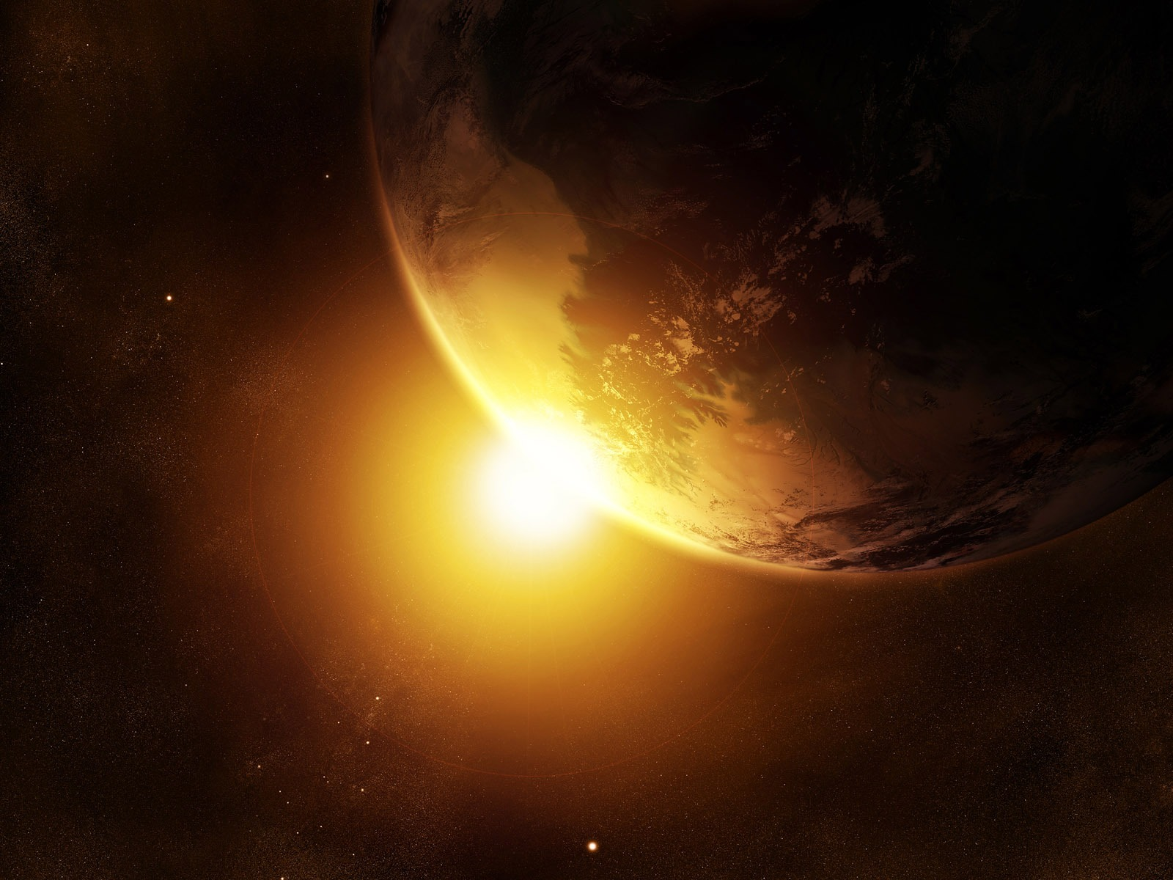
WHO IS GOD?
Join us as we answer this question through a study of God’s Word.
Begins Sunday, MAY 31 at 10:30AM
Harvest Christian Fellowship

Slide 2
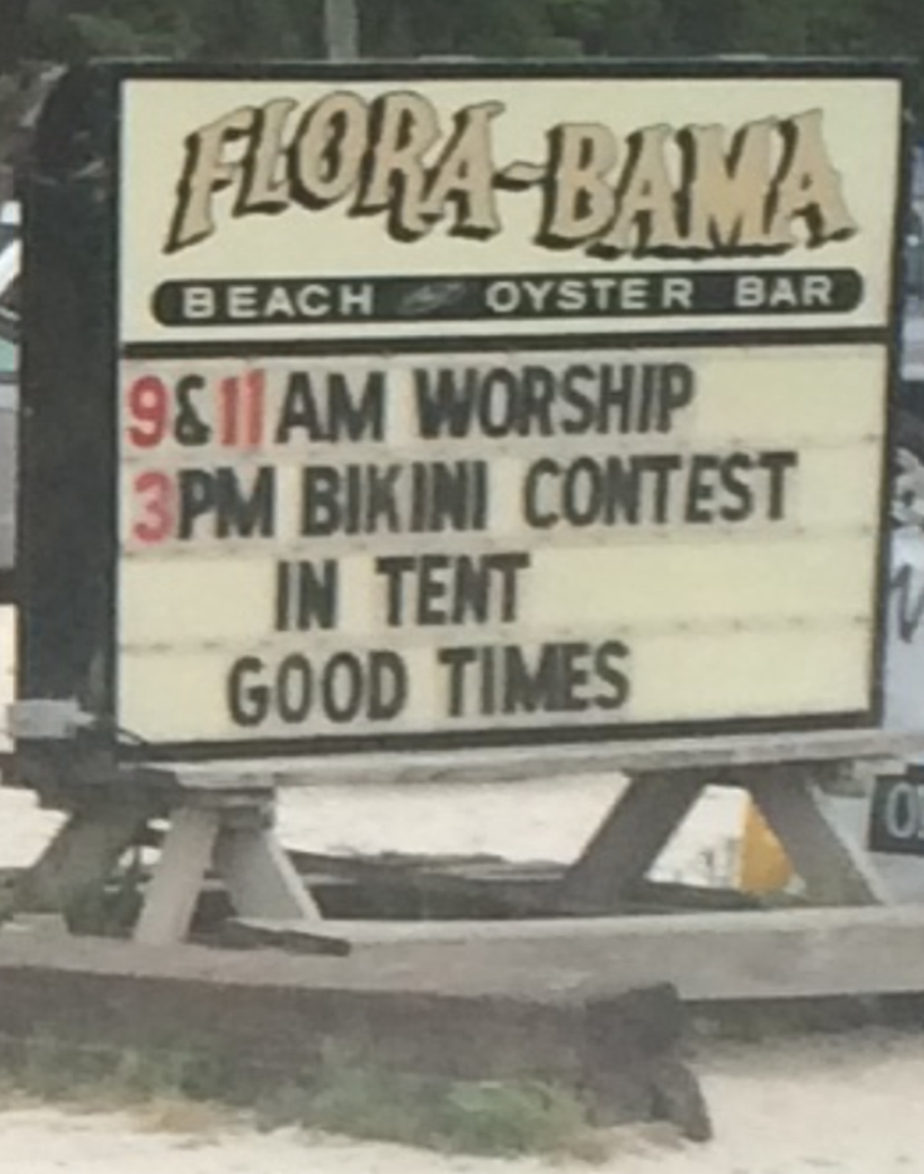

Slide 3
HE IS

Slide 4
HE IS
I AM
Infinite
_______
_______
Finite

Slide 5
HE IS
I AM
_______
His special creation (not a random ________)
Creator
evolution
Genesis 1:1

Slide 6
HE IS
I AM
All Knowing
special
__________
_______ to him
Psalms 139: 1-6

Slide 7
HE IS
I AM
All Present
__________
Never _______ with Him
alone
Psalms 139: 7-12

Slide 8
HE IS
I AM
All Powerful
____________
safe
______ with Him
Revelation 4:8

Slide 9
HE IS
I AM
Sovereign
__________
Someone with a ________ and a plan
purpose
Romans 8:28

Slide 10
HE IS
I AM
eternal
invited
__________
________ to enjoy eternity with Him
I Timothy 1:16, 17

Slide 11
HE IS
I AM
unchanging
__________
Loved by Him ________ from day to day
the same
Hebrews 1:10-12; 13:8

Slide 12
HE IS
I AM
Holy
declared
__________
________ Holy
I Samuel 2:2

Slide 13
HE IS

