Slide 1
God's BIG Plan
A New Sermon Series at

Slide 2
“A Man After God’s own Heart”

Slide 3
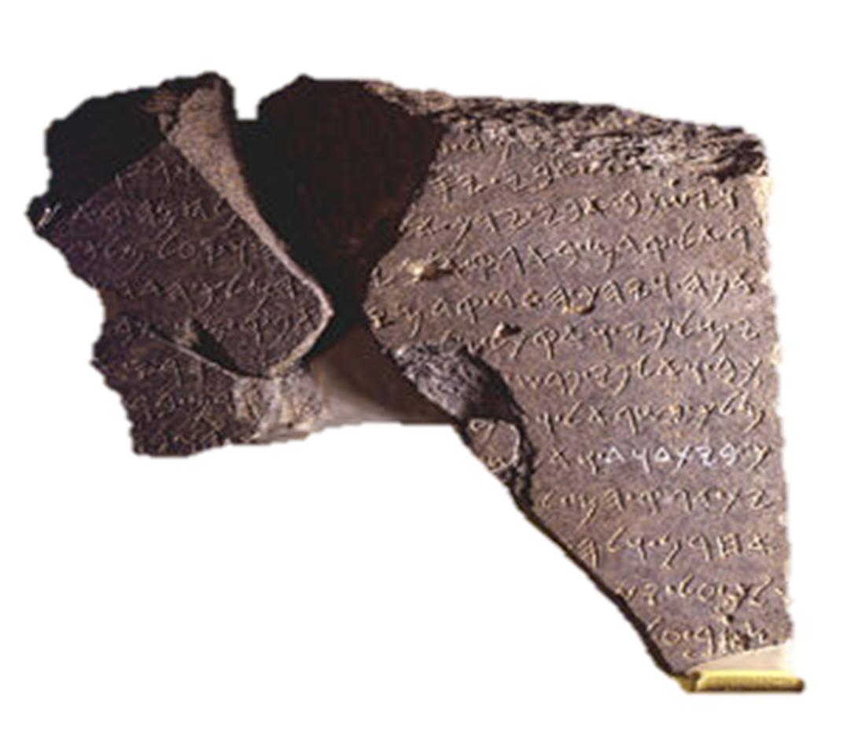
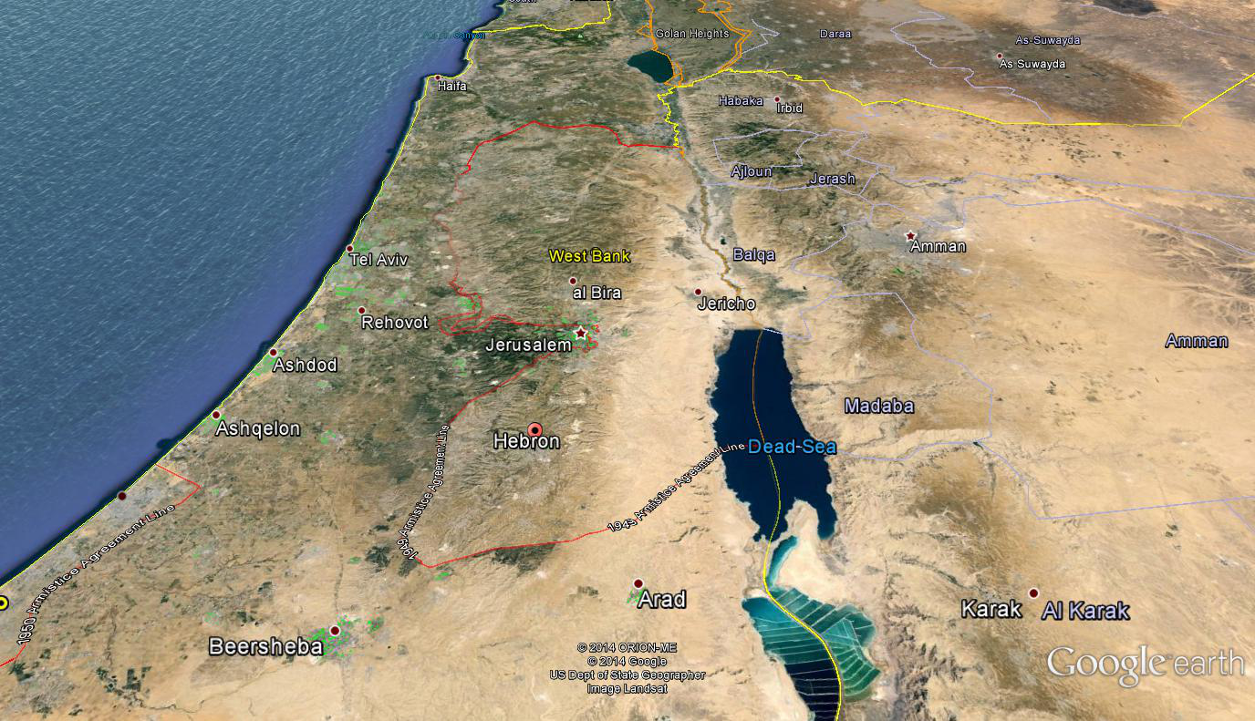
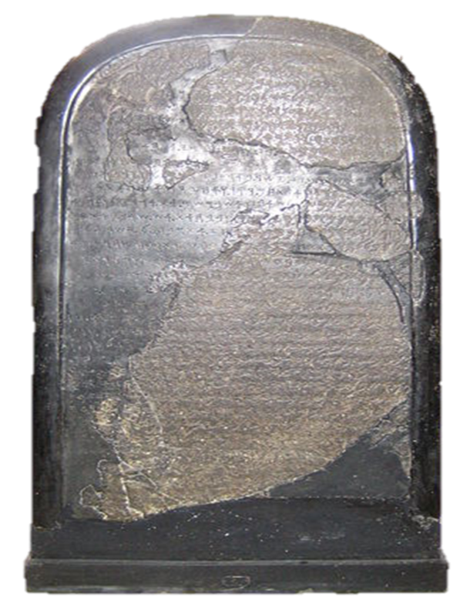
Canaan
MOAB
Bethlehem

Slide 4
A brief timeline of King David’s Life
As a boy, David was anointed by Samuel the Prophet in his hometown of Bethlehem.
David kills Goliath in a battle between Israel and the Philistines during the reign of King Saul.
Saul becomes jealous and David becomes an enemy in Saul’s eyes.
David reigns in Hebron for 7 years.
After Saul and Jonathon are killed in a battle against the Philistines, David begins his reign by capturing Jerusalem.
David reigns in Jerusalem for 33 years.
His son, Solomon becomes king.

Slide 5
“A Man After God’s own Heart”
King David was a man…
1. After God’s Heart. I Samuel 13:13-14.
2. Who faced difficult circumstances and an identity crisis at times. I Samuel 24.

Slide 6
“A Man After God’s own Heart”
King David was a man…
3. Who had a “dysfunctional” family. II Samuel 13-19
• One of his sons committed incest.
• All of his sons murdered another son.
• One of his sons destroyed property and later ran David out of Jerusalem.
4. Who made plenty of mistakes but faced his consequences with confession. Psalms 51.
The Lord never gave up on David and David never gave up on the Lord.

Slide 7
“A Man After God’s own Heart”
King David was a man…
3. Who had a “dysfunctional” family. II Samuel 13-19
• One of his sons committed incest.
• All of his sons murdered another son.
• One of his sons destroyed property and later ran David out of Jerusalem.
4. Who made plenty of mistakes but faced his consequences with confession. Psalms 51.
The Lord never gave up on David and David never gave up on the Lord.

Slide 8
“Sticking Together”
2. Relationships are the __________ of God’s Plan. (Ruth 4:13-22)
Perez
Hezron
Ram
Amminadab
Nashon
Salmon
Boaz
Obed
Jesse
David
Purpose

Slide 9
“Sticking Together”
Naomi and Ruth:
A Story of Humility & Commitment
in Relationships
(Ruth 1:1-18)

