Slide 1


God's BIG Plan
A New Sermon Series at

Slide 2

Fully Giving = Fully Funded
As each believer is Fully Giving, God’s Church is Fully Funded

Slide 3
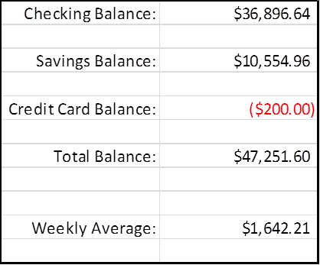
Fully Giving = Fully Funded
As each believer is Fully Giving, God’s Church is Fully Funded

Slide 4
Fully Giving = Fully Funded
As each believer is Fully Giving, God’s Church is Fully Funded

Slide 5
God's BIG Plan
A New Sermon Series at

Slide 6
Fully Giving = Fully Funded
As each believer is Fully Giving, God’s Church is Fully Funded
Thank you for your faithful giving to the ministry and your effort to make disciples of all men, for the Harvest is plentiful but the workers are few!
The Savior’s Vision: Then He said to His disciples, "The harvest is plentiful, but the workers are few. 38 "Therefore beseech the Lord of the harvest to send out workers into His harvest." Matthew 9:36-37
Worship the Savior Ascribe to the LORD the glory due to His name; Worship the LORD in holy array. Psalm 29:2

Slide 7
Fully Giving = Fully Funded
As each believer is Fully Giving, God’s Church is Fully Funded
Work the Savior’s Vision (Serving)
For just as we have many members in one body and all the members do not have the same function, 5 so we, who are many, are one body in Christ, and individually members one of another. 6 Since we have gifts that differ according to the grace given to us, each of us is to exercise them accordingly. Romans 12:4

Slide 8
Fully Giving = Fully Funded
As each believer is Fully Giving, God’s Church is Fully Funded
Fund the Savior’s Vision (Giving)
Be a generous and cheerful giver (attitude)
Each one must do just as he has purposed in his heart, not grudgingly or under compulsion, for God loves a cheerful giver. II Corinthians 9:7
Be a decisive and committed giver (action)
Now concerning the collection for the saints, as I directed the churches of Galatia, so do you also. 2 On the first day of every week each one of you is to put aside and save, as he may prosper I Corinthians 16:1-2

Slide 9
Fully Giving = Fully Funded
As each believer is Fully Giving, God’s Church is Fully Funded
"Do not store up for yourselves treasures on earth, where moth and rust destroy, and where thieves break in and steal. "But store up for yourselves treasures in heaven, where neither moth nor rust destroys, and where thieves do not break in or steal; for where your treasure is, there your heart will be also. Matthew 6:19-21

Slide 10
Fully Giving = Fully Funded
As each believer is Fully Giving, God’s Church is Fully Funded
#1: Our vision for growing spiritually is worthy of funding. We will need curriculum, supplies, equipment, etc.
#2: Our vision for growing numerically is worthy of funding. We will need a bigger building.

Slide 11
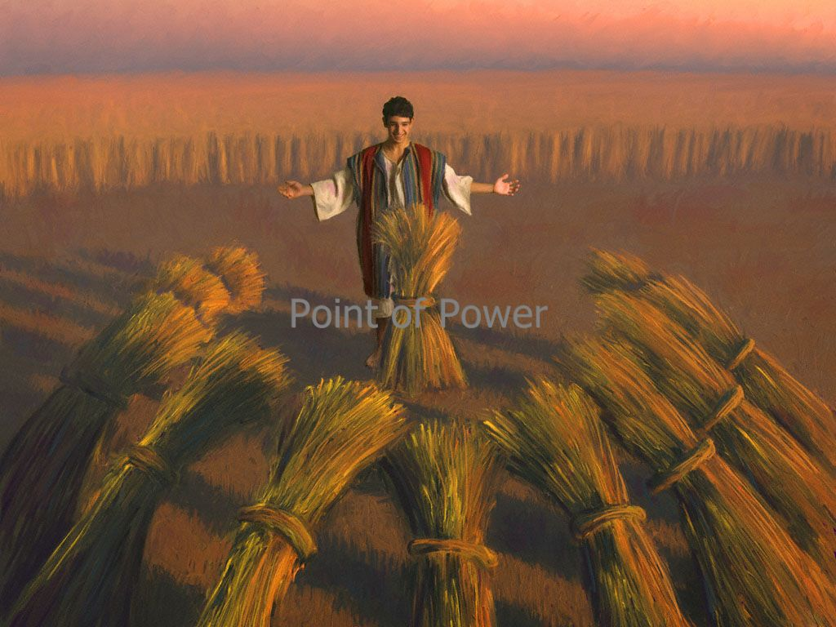
Fully Giving = Fully Funded
As each believer is Fully Giving, God’s Church is Fully Funded
Trust the Savior’s BIG Plan! Genesis 42:6 & Genesis 50:15-20.
JOSEPH’S DREAMS

