Slide 1
God's BIG Plan
God’s BIG Plan was for:
A People. (Who would birth the Messiah)
A Place. (Where many could be reached)
3. A Promise. (For anyone who wants salvation.)
Involves Me?
A New Sermon Series at

Slide 2
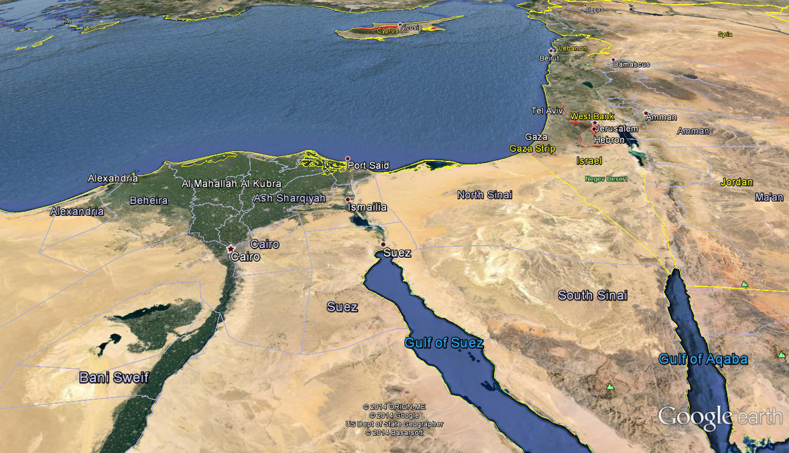
MIDIAN

Slide 3
Wake up its Me!
Today’s Sermon takes place during the period of the Judges during 12th Century BC. The main character is Gideon, who lives in Oprah (Modern day Taybeh, Palestine)

Slide 4
Wake up its Me!
God’s BIG Plan was for:
A People. (Who would birth the Messiah)
A Place. (Where many could be reached)
A Promise. (For anyone who wants salvation.)
God loves people. His love is full of mercy and grace. The scripture says He is patient and forgiving. In this passage, we will see that the Lord will do just about anything to get someone’s (or a nation’s) attention, including hardship. Once He has our attention, blessings follow!

Slide 5
Wake up its Me!
Wake up! I love you! Judges 2:11-23.

Slide 6
Wake up its Me!
2. Wake up! Listen to me! Judges 6:1-10.

Slide 7
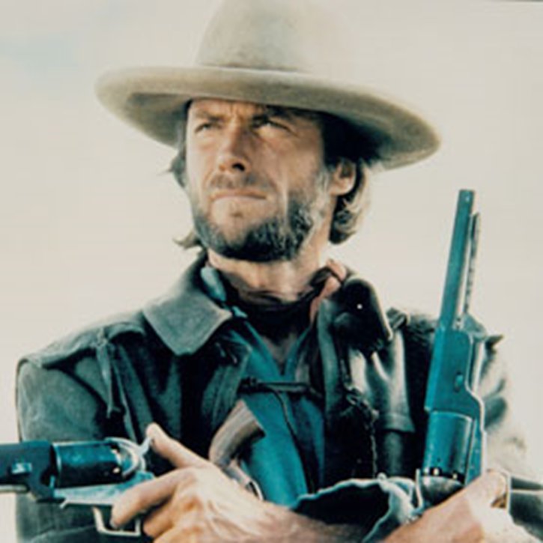
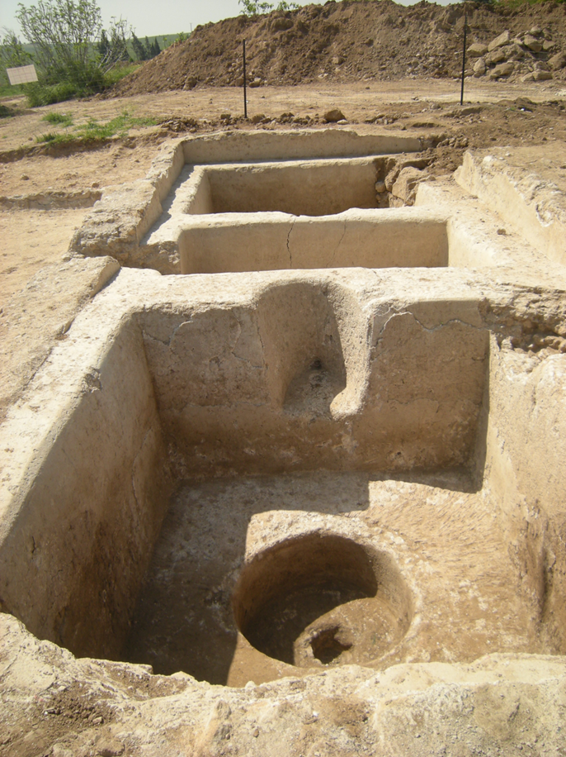
Wake up its Me!
3. Wake up! I want to use you! Judges 6:11-24.

Slide 8
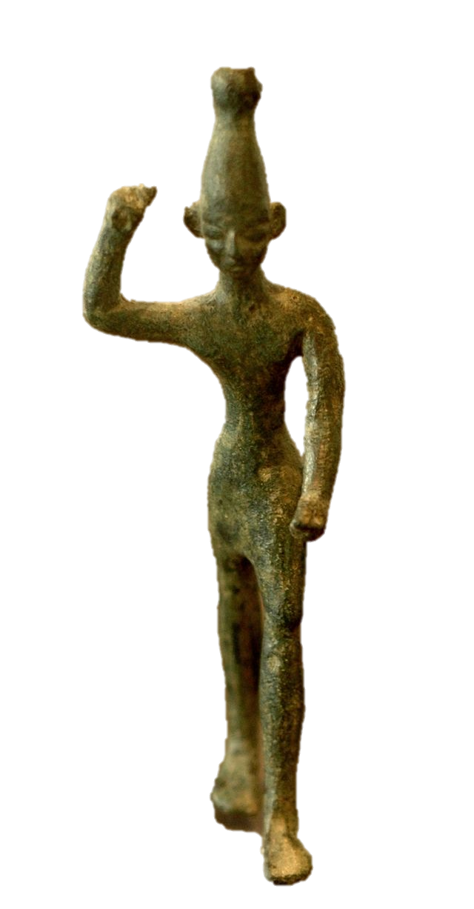
Wake up its Me!
4. Wake up! I want to rescue you from deception. 6:25-32.
BAAL ASHERAH

Slide 9
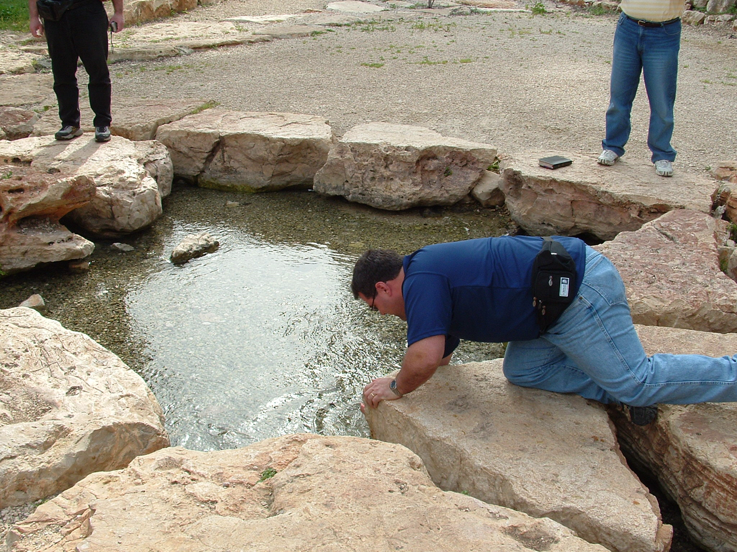
Wake up its Me!
5. Wake up! See my glory! 6:33-7:9.
The Spring of Harod

Slide 11
God's BIG Plan
A New Sermon Series at

