Slide 1
God's BIG Plan
God’s BIG Plan was for:
A People. (Who would birth the Messiah)
A Place. (Where many could be reached)
3. A Promise. (For anyone who wants salvation.)
A New Sermon Series at

Slide 2
Today: What does it take to bow?
Exodus 6:28 – 10:29
The Characters
Moses - God’s spokesman (6:28-30)
Pharoah – Ruler of a mighty nation, regarded as divine; one of the gods
God – Yahweh, the one true God, who wants all people to know He is Lord! (7:5)

Slide 3
Today: What does it take to bow?
Exodus 6:28 – 10:29
1. Pre-plague encounter (7:8-13)
The Events
SEVERE IRRITATIONS-plague encounter (7:8-13)
2. First 3 plagues (7:14-8:19)
Blood
Frogs
Gnats

Slide 4
Today: What does it take to bow?
Exodus 6:28 – 10:29
GOD MAKES A DISTINCTION
Second 3 plagues (8:20-9:12)
Flies
Livestock Disease
Boils on man and beast

Slide 5
Today: What does it take to bow?
Exodus 6:28 – 10:29
DEVASTATION & DESPARATION
Third 3 plagues (9:13-10:29)
a. Hail
b. Locusts
c. Darkness

Slide 6
Today: What does it take to bow?
Exodus 6:28 – 10:29
The Lessons
1. Moses’ lips (6:28-30)
a. Moses spoke with GOD’S AUTHORITY.
b. God QUALIFIES THE CALLED.
D.L. Moody: “Moses spent forty years in Pharaoh’s court thinking he was somebody, forty years in the desert learning that he was nobody, and forty years showing what God can do with a somebody who found out he was a nobody.”

Slide 7
Today: What does it take to bow?
Exodus 6:28 – 10:29
The Lessons
2. Pharaoh’s heart
a. After every plague, HIS HEART IS HARDENED.
b. Who hardened it? BOTH PHARAOH AND GOD
c. God’s reasonsP
i. To proclaim His power and glory (9:15)
ii. To show His absolute sovereignty.
(Romans 9:17-18 & Romans 1:24-26)

Slide 8
Today: What does it take to bow?
Exodus 6:28 – 10:29
c. God’s reasonsP
i. To proclaim His power and glory (9:15)
ii. To show His absolute sovereignty.
Romans 9:17-18 “’For this very purpose I raised you up, to demonstrate My power in you, and that My name might be proclaimed throughout the whole earth.’ So then He has mercy on whom He desires, and He hardens whom He desires.”
Romans 1:24-26 “Therefore God gave them over in the lusts of their hearts to impurity…for they exchanged the truth of God for a lie, and worshiped and served the creature rather than the Creator…”

Slide 9
Today: What does it take to bow?
Exodus 6:28 – 10:29
3. God’s hand
a. IN JUDGMENT, the Egyptians may know He is Lord.
7:5 “And the Egyptian shall know that I am the Lord, when I stretch out My hand on Egypt and bring out the sons of Israel from their midst.”
b. IN SALVATION, the Israelites may know He is Lord.
10:2 “that you may tell in the hearing of your son, and of your grandson, how I made a mockery of the Egyptians, and how I performed My signs among them; that you may know that I am the Lord.”

Slide 10
Today: What does it take to bow?
Exodus 6:28 – 10:29
Philippians 2:9-11 “Therefore also God highly exalted Him, and bestowed on Him the name which is above every name, that at the name of Jesus EVERY KNEE SHOULD BOW, of those who are in heaven, and on earth, and under the earth and that every tongue should confess that Jesus Christ is Lord, to the glory of God the Father.”
Have you bowed? Have you confessed?

Slide 11
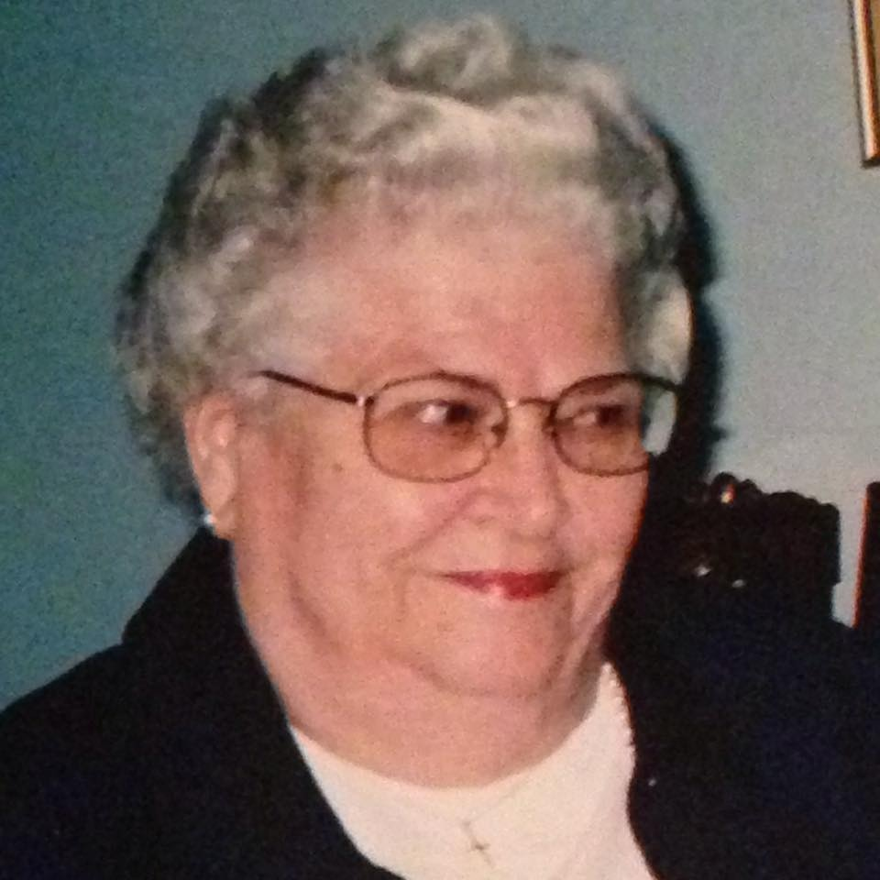
Today: What does it take to bow?
Exodus 6:28 – 10:29
October 22nd
Have you bowed?
Have you confessed?

