Slide 1
God's BIG Plan
A New Sermon Series at

Slide 2
Who are You Following?
Today’s Passage is from I Kings 18:16-39
(about 850 BC)
Israel had abandoned their faith in the Lord to follow fake idols. In the midst of their unbelief, the Lord called a man named Elijah to preach the truth to the people. God pursued these unbelieving people because of His love for them. In the same way, the Lord pursues people today. He reveals Himself so that others may believe in Him and follow him. Have you chosen to follow Him?
Israel’s decay into a world of idolatry hastened during the reign of Solomon. (971 BC - 931 BC)

Slide 3
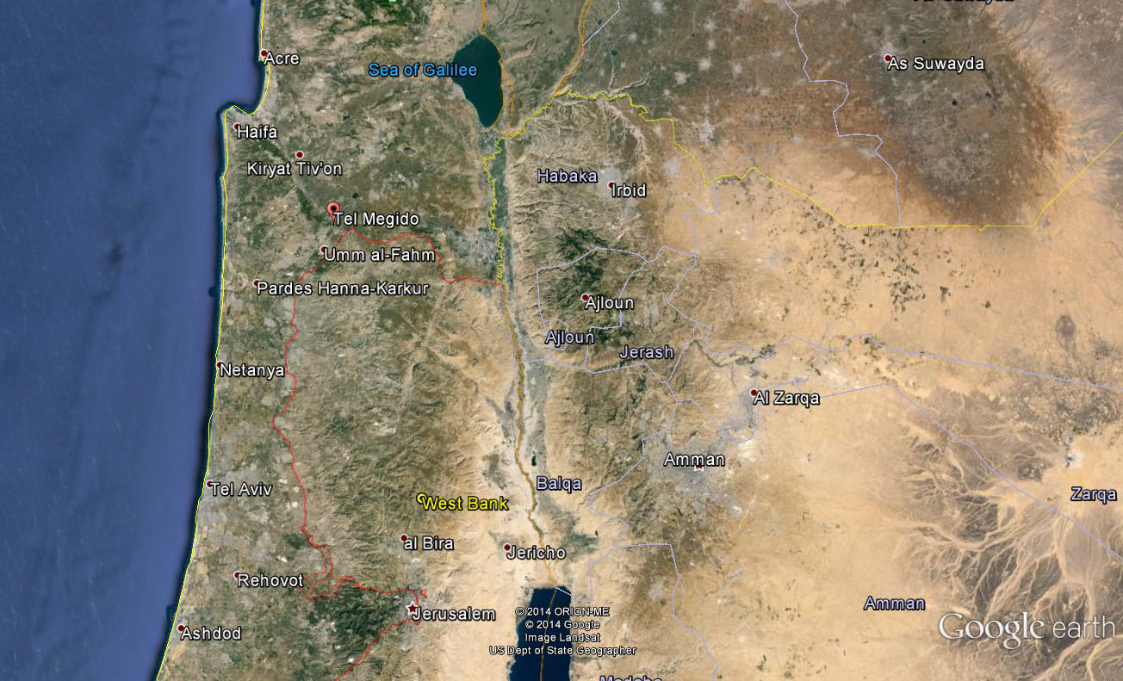
Mt. Carmel

Slide 4
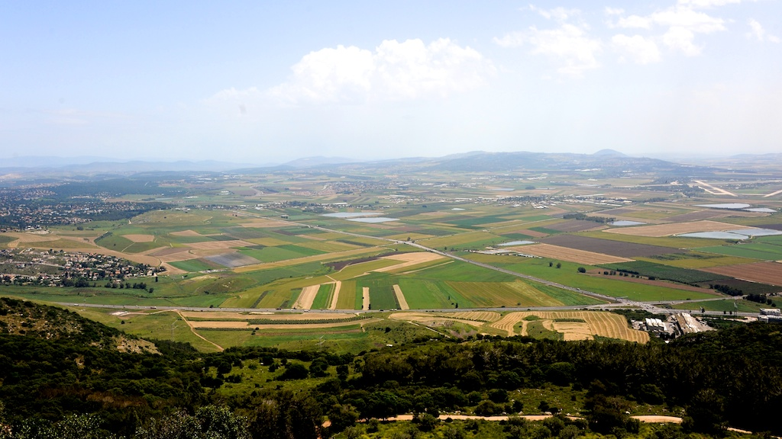

Slide 5
Who are You Following?
Today’s Passage is from I Kings 18:16-39
(about 850 BC)
Israel…
1. was deceived by fake idols/gods. I Kings 11:1-8
What idols are fighting to have power over me?

Slide 6
Who are You Following?
Today’s Passage is from I Kings 18:16-39
(about 850 BC)
Israel…
2. was faced with a spiritual choice. (I Kings 18:17-21)
• Follow the Lord & abandon their idols.
(or)
• Follow baal.

Slide 7
Who are You Following?
Today’s Passage is from I Kings 18:16-39
(about 850 BC)
Israel…
3.was eyewitness to God’s… (I Kings 18:22-39)
•Realness (& the fakeness of their idols).
•Power (& the absence of their idols).
•Jealous pursuit of them (& the emptiness of their idols).

Slide 8
Who are You Following?

