Slide 1
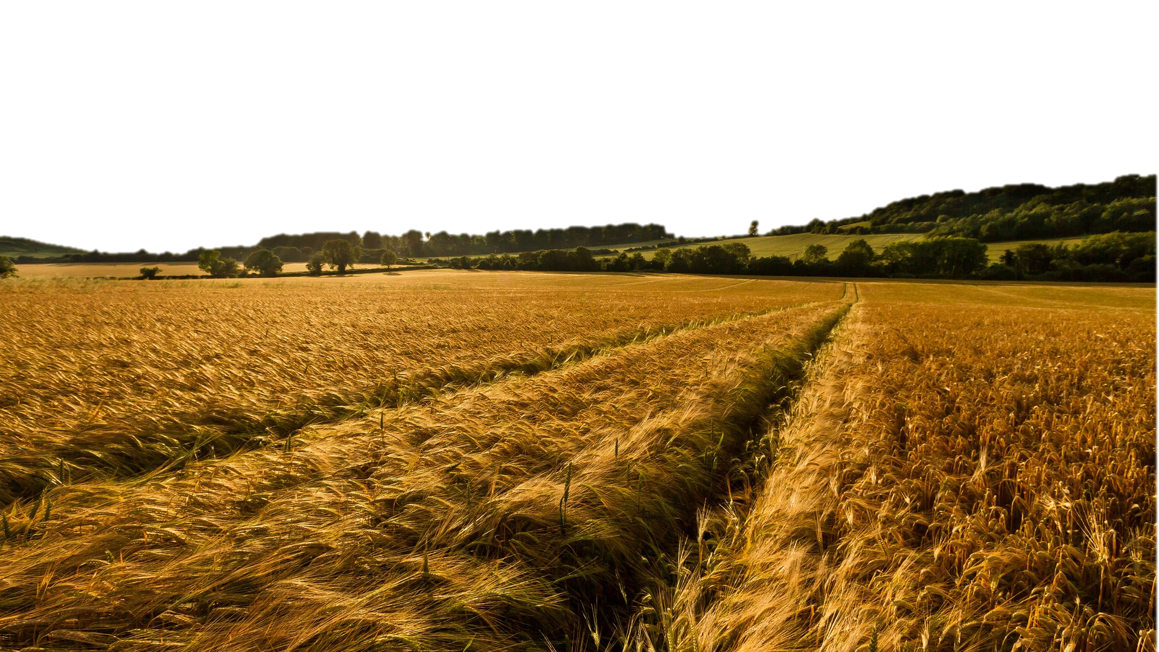
The Harvest Strategy
Saying “Yes” to the Great Commission
Part 3 in “The Harvest Strategy” Series

Slide 2
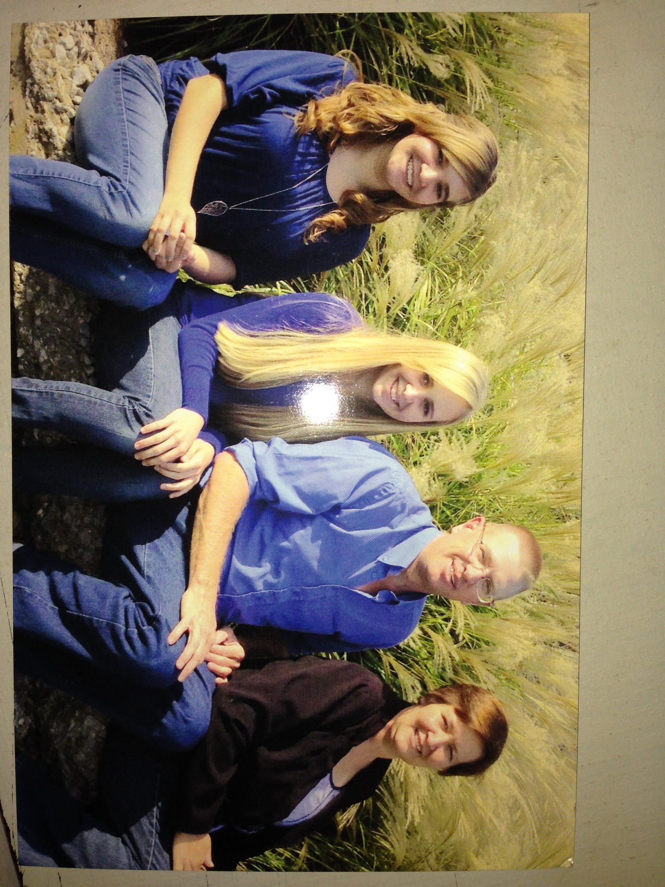

Slide 3
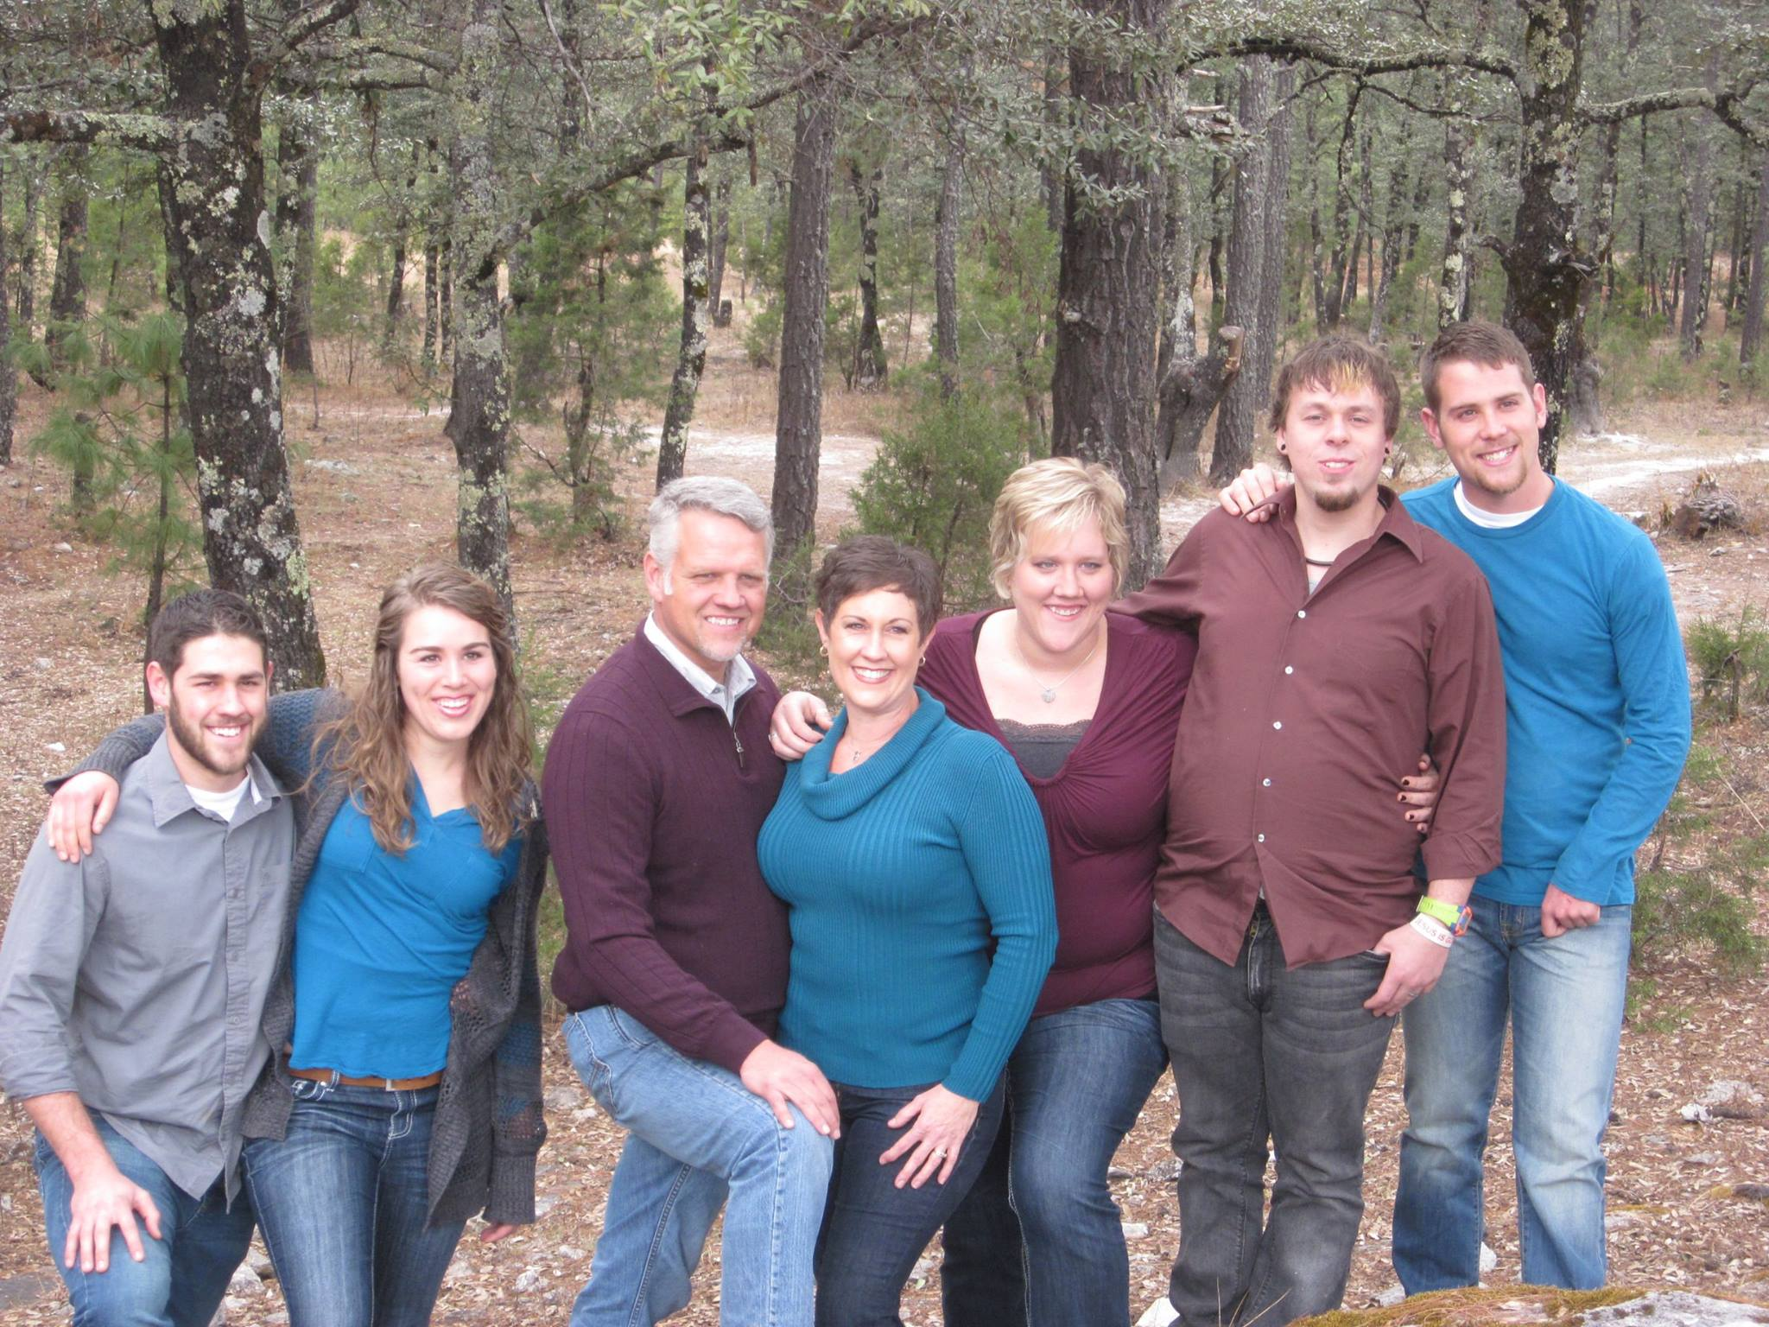
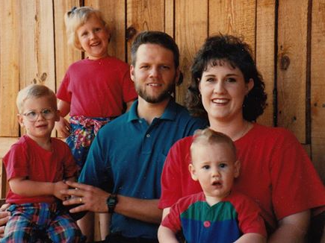

Slide 4
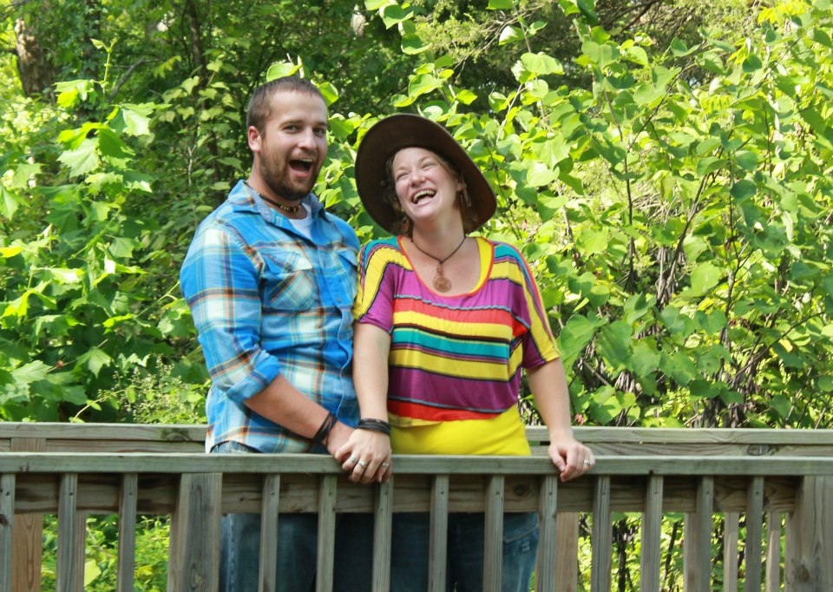

Slide 5
The Harvest Strategy
Saying “Yes” to the Great Commission
Part 3 in “The Harvest Strategy” Series
At Harvest we believe that “A Great Commitment to the Great Commandment & the Great Commission will grow a Great Church!” (Rick Warren)
The Great Commandment: “Jesus said, ‘Love the Lord your God with all your heart...soul...and mind. This is the first and greatest commandment. And the second is like it: Love your neighbor as yourself. All the Law and Prophets hang on these two commandments.’” Matthew 22:36-40

Slide 6
The Harvest Strategy
Saying “Yes” to the Great Commission
Part 3 in “The Harvest Strategy” Series
The Great Commission: Therefore go and make disciples of all nations, baptizing them in the name of the Father and of the Son and of the Holy Spirit, and teaching them to obey everything I have commanded you. Matthew 28:19-20.
TODAY: John 9:1-38: The Great Commissioner Models the Great Commission.

Slide 7
The Harvest Strategy
Saying “Yes” to the Great Commission
Part 3 in “The Harvest Strategy” Series
READ John 9:1-3. Saying “Yes” to the Great Commission means…
I will have compassion (not judgment) on LOST PEOPLE.
Jesus noticed someone that others ignored or were critical of.
Jesus has compassion on those who can’t see physically.
Jesus has compassion on those who can’t see spiritually.

Slide 8
The Harvest Strategy
Saying “Yes” to the Great Commission
Part 3 in “The Harvest Strategy” Series
READ John 9:1-3. Saying “Yes” to the Great Commission means…
READ John 9:4-38. I will Pursue LOST PEOPLE.
While I still have time.
To help them with their physical needs (John 9:6-12)
To help them with their spiritual needs (John 9:25-38)
Am I showing Jesus to lost People or Hiding Him? READ Matthew 5:13-16.

Slide 9
The Harvest Strategy
Saying “Yes” to the Great Commission
Part 3 in “The Harvest Strategy” Series
I will Say YES to the Great Commission. I ‘m needed & will help Harvest Grow!
2 Types of Growth that a Church should experience:
I’ll help Harvest Grow in Maturity. (Quality-Helping those in the Church.)
I’ll help Harvest Grow in Disciples. (Quantity -Inviting LOST PEOPLE outside the Church to become a part of the Church.)
3 types of Help I can provide:
By my financial giving.
By my Works of Service.(use my gift in a Harvest Ministry)
By my Prayer.

Slide 10
The Harvest Strategy
Saying “Yes” to the Great Commission
Part 3 in “The Harvest Strategy” Series

