Slide 1
Learning what it means to be a disciple of Jesus

Slide 2
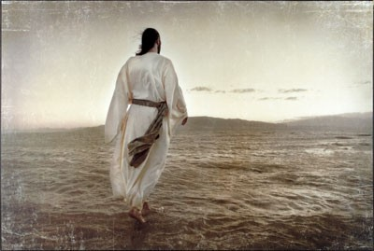
COME FOLLOW ME Learning what it means to be a disciple of Jesus

Slide 3
COME FOLLOW ME Learning what it means to be a disciple of Jesus
A dis●ci●ple: A follower
How do I become a Disciple? It starts at your salvation.
A Disciple of Jesus is disciplined.

Slide 4
COME FOLLOW ME Learning what it means to be a disciple of Jesus
A Disciple…
Read II Timothy 1: 1-4
Spends time praying for others.

Slide 5
COME FOLLOW ME Learning what it means to be a disciple of Jesus
A Disciple…
Read II Timothy 1:5-6
Spends time using his/her spiritual gifts on others.

Slide 6
COME FOLLOW ME Learning what it means to be a disciple of Jesus
A Disciple…
Read II Timothy 1:5-6 Spends time developing others.

Slide 7
COME FOLLOW ME Learning what it means to be a disciple of Jesus
A Disciple…
Read II Timothy 1:7 -11 Spends time with others.

Slide 8
COME FOLLOW ME Learning what it means to be a disciple of Jesus
A Disciple…
Read II Timothy 1:12-18 Spends time in God’s Word alone & with others.

Slide 9
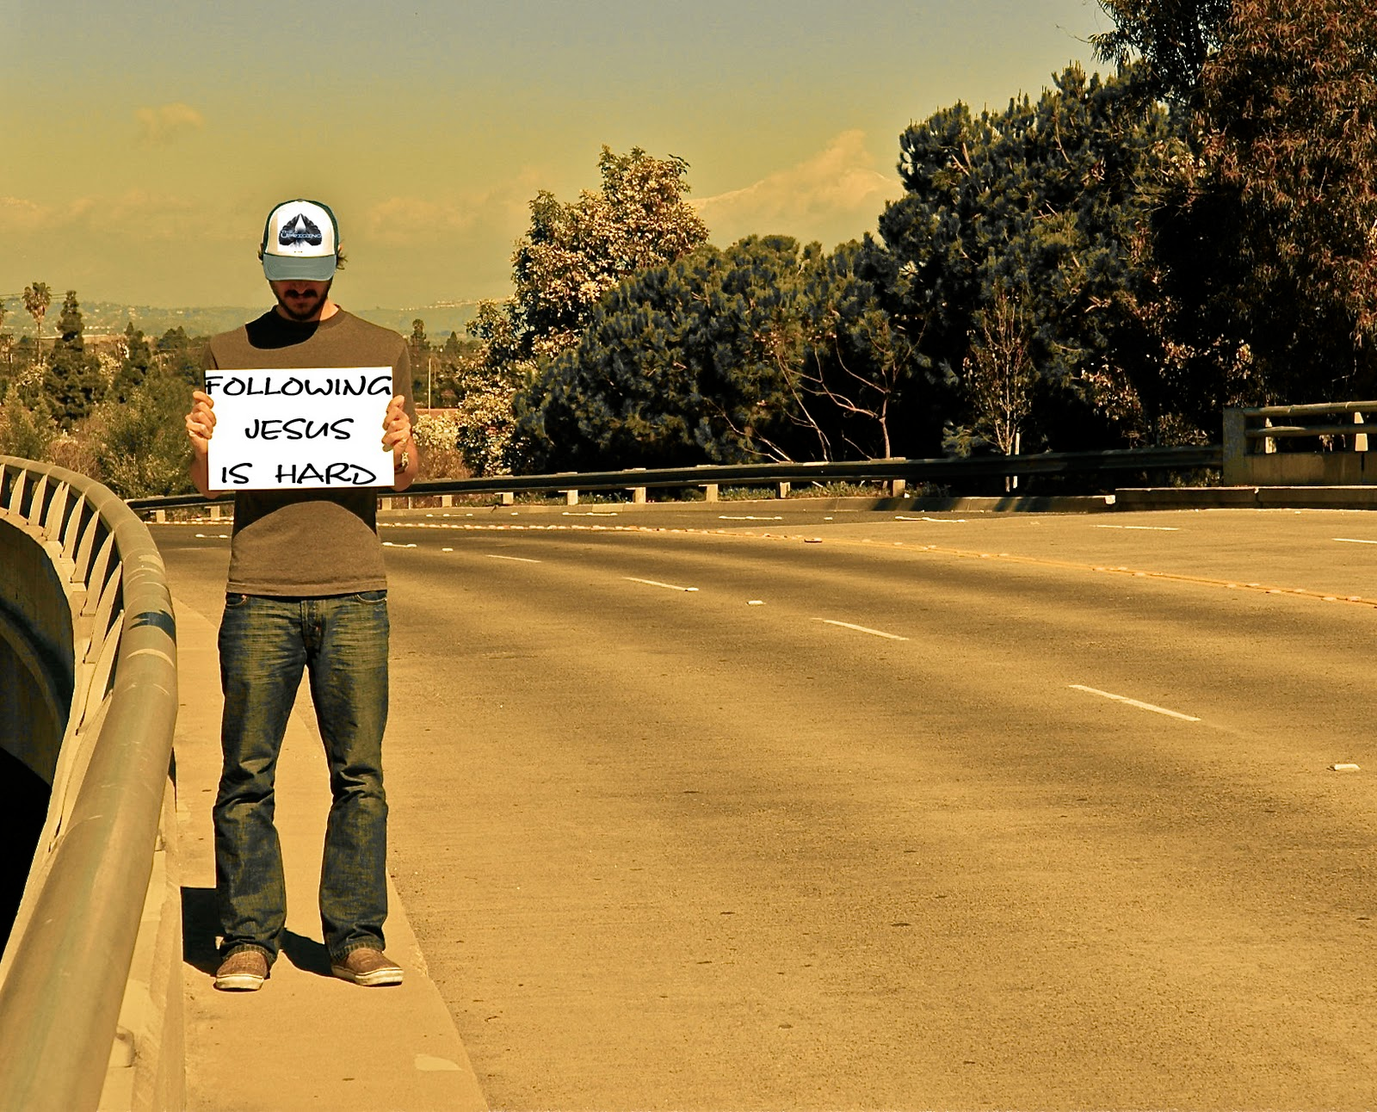
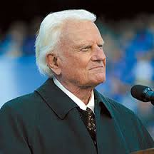
"Salvation is free, but discipleship costs everything we have.”
Billy Graham

Slide 10
COME FOLLOW ME Learning what it means to be a disciple of Jesus

