Slide 1
WHO IS GOD?
Join us as we answer this question through a study of God’s Word.
Sunday, at 10:30AM
Harvest Christian Fellowship

Slide 2
THE DEITY OF JESUS
IS REVEALED…

Slide 3
THE DEITY OF JESUS
IS REVEALED…
1) By His Prophecy
Jeremiah 23:5,6. Jesus is the
Isaiah 7:14/Matthew 1:18-23. Immanuel means God
Lord
with us.

Slide 4
THE DEITY OF JESUS
IS REVEALED…
2) By His Titles
Cross-reference Isaiah 44:6 and Revelation 1:17
Jesus is the תא AΩ
Beginning and the End.

Slide 5
THE DEITY OF JESUS
IS REVEALED…
3) By His Claims
Mark 2:1-13 Jesus is the only one who can
forgive my sins & heal miraculously.

Slide 6
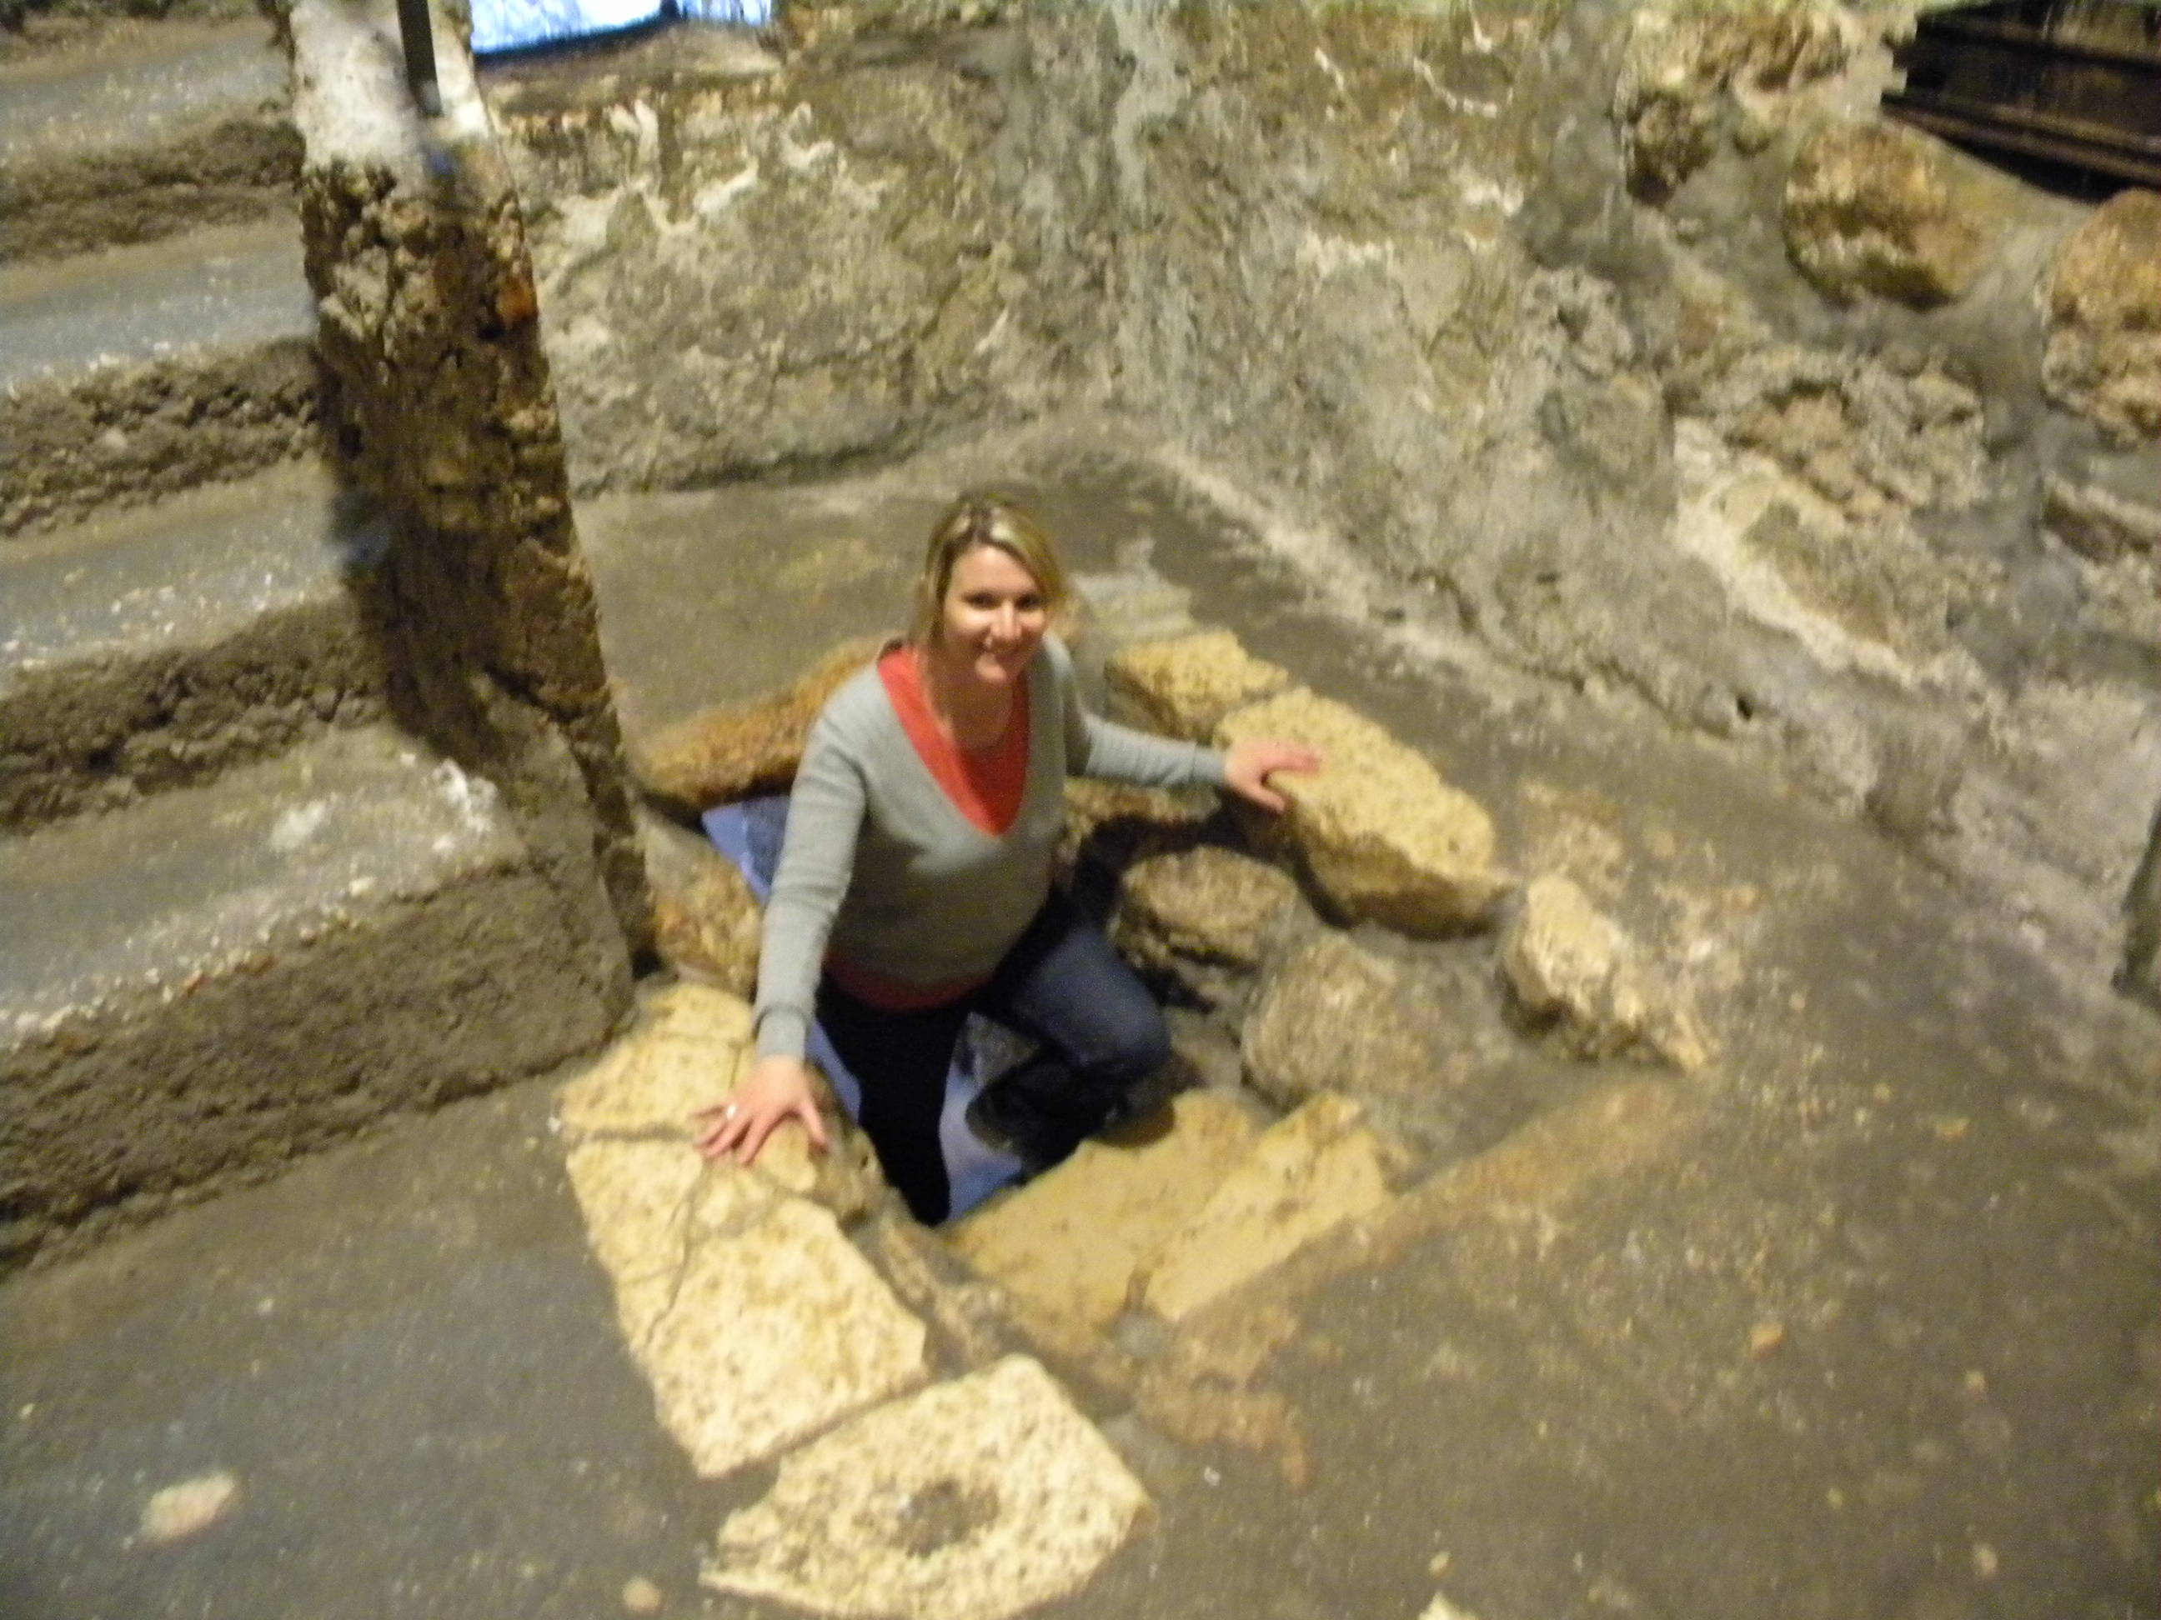
THE DEITY OF JESUS
IS REVEALED…
4) By His Power over all things, even death (Miracles)
John 11:1-45
John 2:1-22

Slide 7
THE DEITY OF JESUS
IS REVEALED…
5) By His Witnesses
By the Apostles (John 1:1)

Slide 8
THE DEITY OF JESUS
IS REVEALED…

