Slide 1
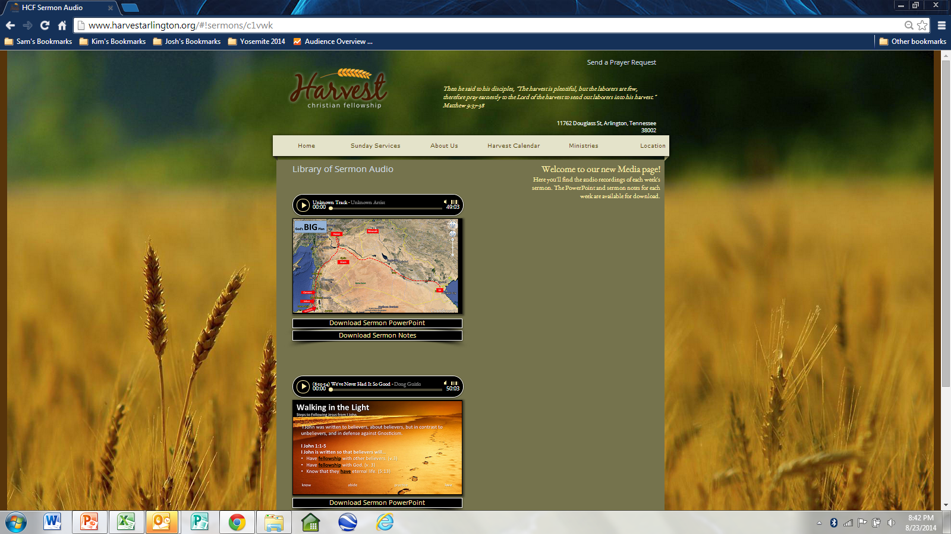

Slide 2
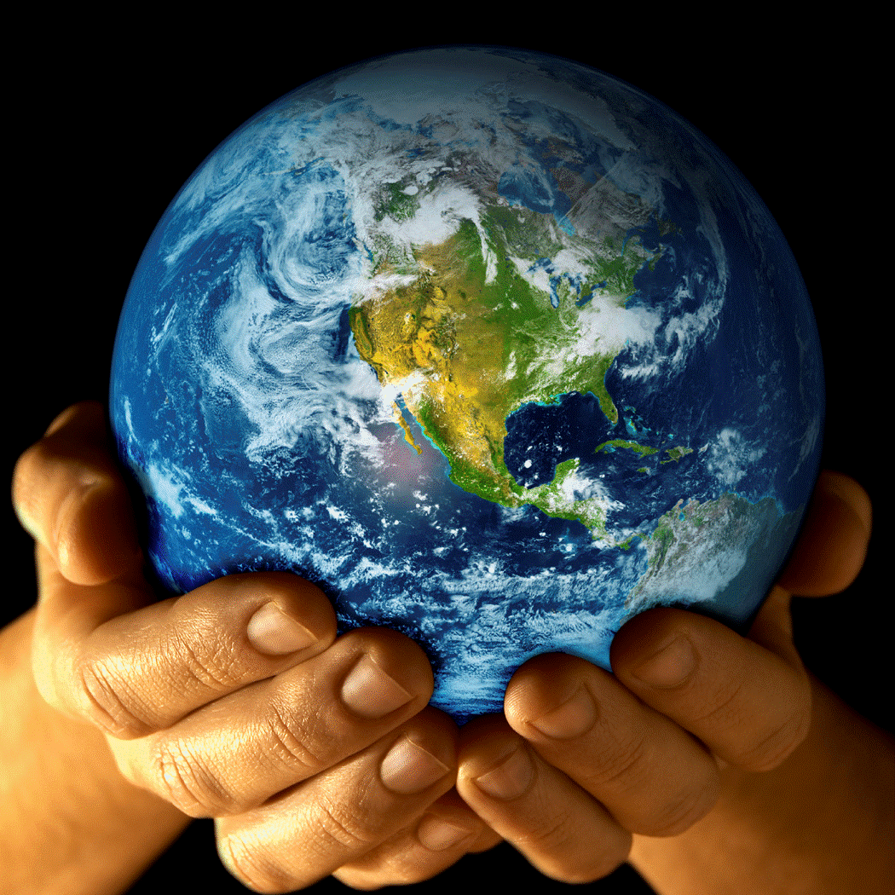
God's BIG Plan
Doesn’t always
make sense to me! (or feel good!)
A New Sermon Series at

Slide 3
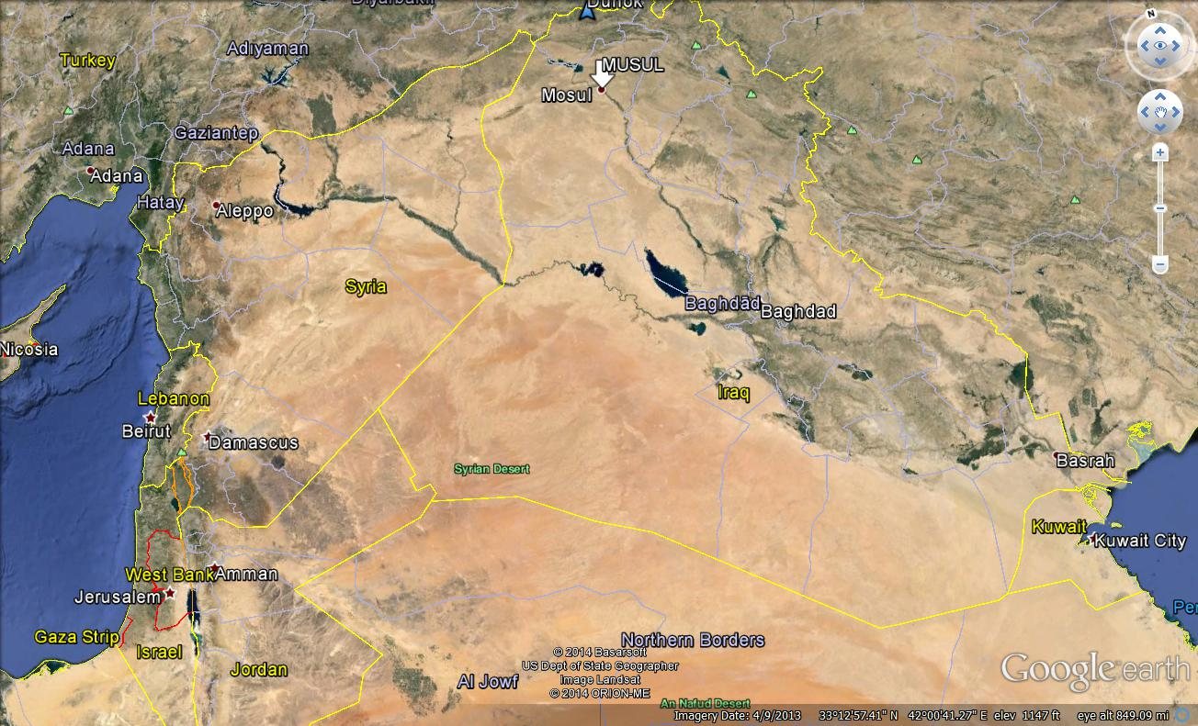
Ninevah
Doesn’t always
make sense to me! (or feel good!)
Haran
Aram
Canaan
Ur
Jebus
Hebron

Slide 4
RELATIONSHIP
God’s BIG Plan was for:
1. A People. (Who would birth the Messiah)
2. A Place. (Where many could be reached)
3. A Promise. (For anyone who wants salvation.)
Doesn’t always
make sense to me! (or feel good!)
Genesis 22:1-2
Abraham is being by God.
Temptations
Designed by the (or a desire of my flesh).
Look & feel at first but turn out to be for me.
Designed for my to show my disobedience.
Tests
Designed by the .
Look & feel at first but turn out to be for me.
Designed for my success to prove my obedience.
Canaan
tested
Doesn’t always
make sense to me! (or feel good!)
enemy
Jebus
good
bad
failure
Phillistines
Hebron
LORD
bad
good
James 1:2 Consider it all joy, my brethren, when you encounter various trials, knowing that the testing of your faith produces endurance. And let endurance have its perfect result, so that you may be perfect and complete, lacking in nothing.

Slide 5
RELATIONSHIP
God’s BIG Plan was for:
1. A People. (Who would birth the Messiah)
2. A Place. (Where many could be reached)
3. A Promise. (For anyone who wants salvation.)
Doesn’t always
make sense to me! (or feel good!)
Canaan
Genesis 22:3-5
Abraham had that God would Isaac after the sacrifice and stick to His Plan & Promise. Hebrews 11:17-19
Genesis 22:6-11
Abraham showed even when it didn’t make sense or feel good.
Genesis 22:12-19
Abraham was willing to trust God for anything, am ?
faith
resurrect
Doesn’t always
make sense to me! (or feel good!)
Jebus
Phillistines
Obedience and faith
Hebron
I

Slide 6
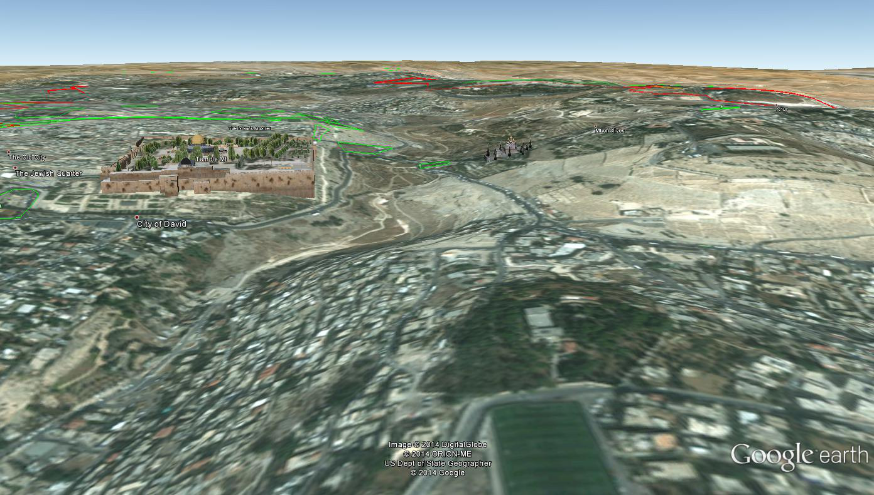
Mount Moriah

