Slide 2
“What’s the Purpose of Life?”
“Why do I live my Life the way I do?”
“I’d like a better Life.”

Slide 3
GOD’S PEOPLE FINDING GOD’S HEART FOR THE WORLD
PART 1: CONNECT WITH THE LOST
https://www.youtube.com/watch?v=8PgbhbkSnbc
LIFE WITHOUT PURPOSE!

Slide 4
GOD’S PEOPLE FINDING GOD’S HEART FOR THE WORLD
PART 1: CONNECT WITH THE LOST
Failed Missions
(You just had 1 job!)

Slide 5
GOD’S PEOPLE FINDING GOD’S HEART FOR THE WORLD
PART 1: CONNECT WITH THE LOST
Failed Missions
(You just had 1 job!)

Slide 6
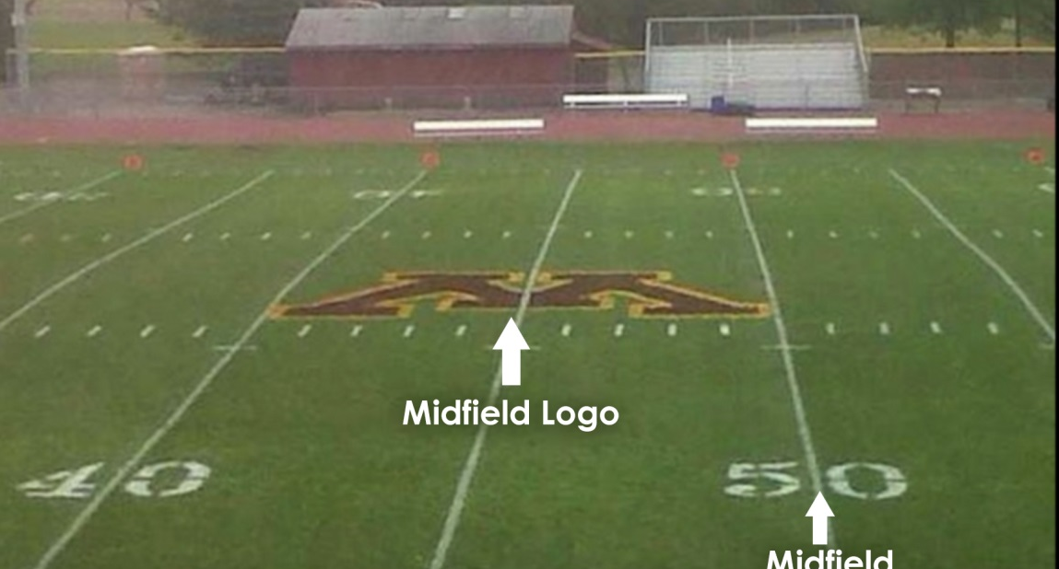
GOD’S PEOPLE FINDING GOD’S HEART FOR THE WORLD
PART 1: CONNECT WITH THE LOST
Failed Missions
(You just had 1 job!)

Slide 7
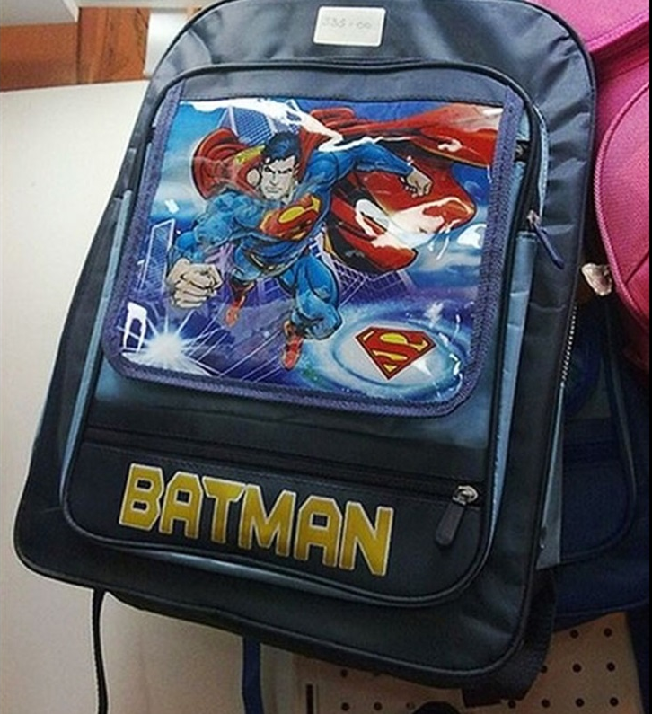
GOD’S PEOPLE FINDING GOD’S HEART FOR THE WORLD
PART 1: CONNECT WITH THE LOST
Failed Missions
(You just had 1 job!)

Slide 8
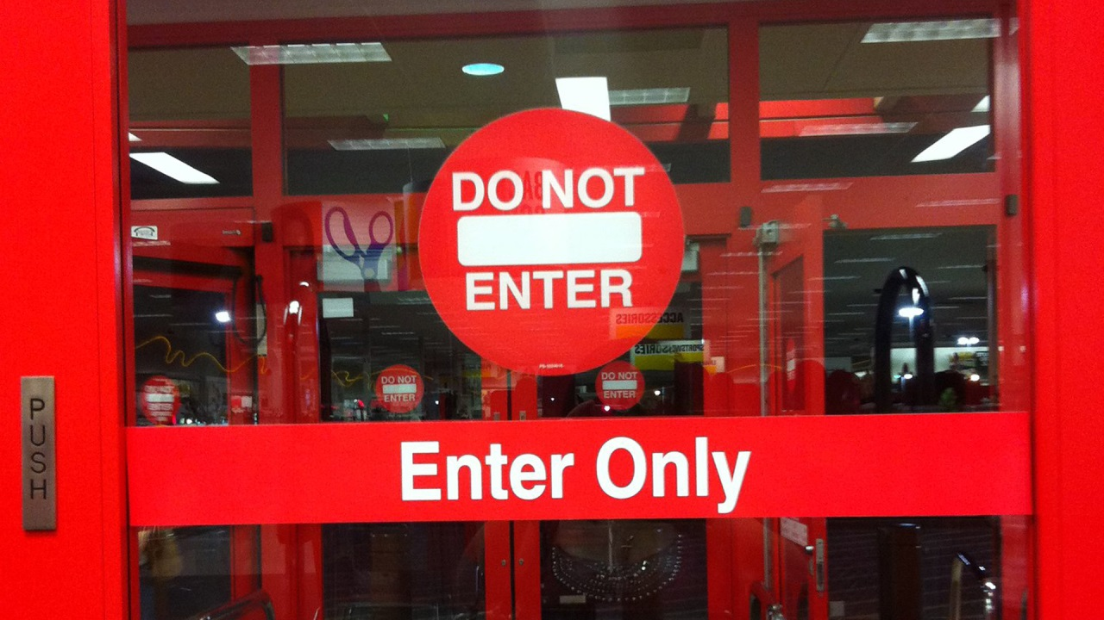
GOD’S PEOPLE FINDING GOD’S HEART FOR THE WORLD
PART 1: CONNECT WITH THE LOST
Failed Missions
(You just had 1 job!)

Slide 9
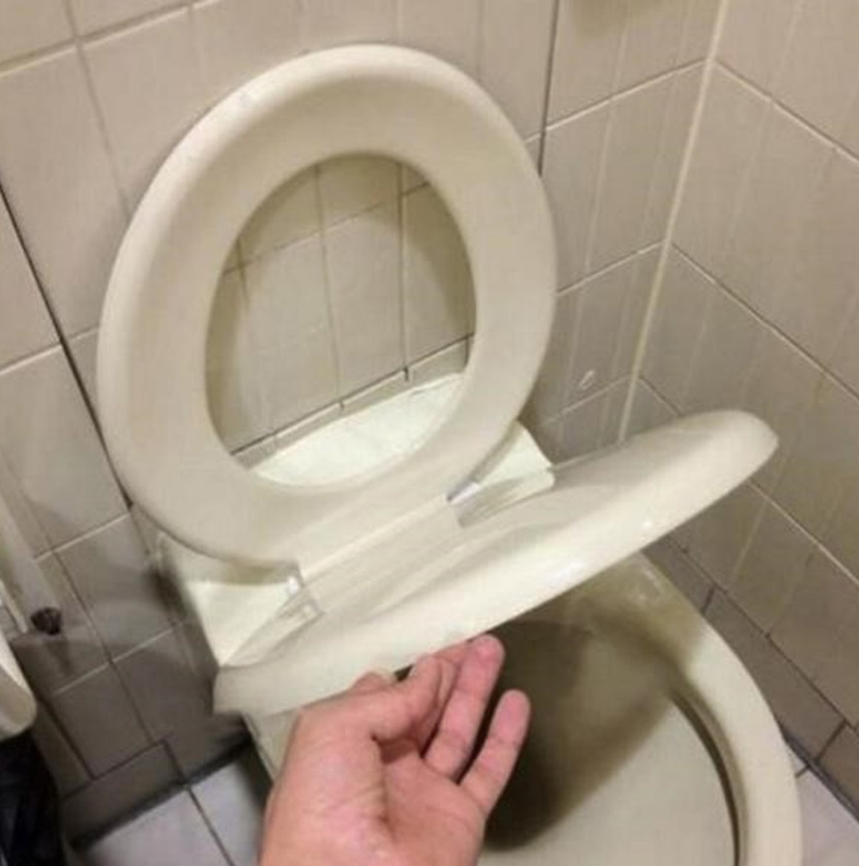
GOD’S PEOPLE FINDING GOD’S HEART FOR THE WORLD
PART 1: CONNECT WITH THE LOST
Failed Missions
(You just had 1 job!)

Slide 10
GOD’S PEOPLE FINDING GOD’S HEART FOR THE WORLD
PART 1: CONNECT WITH THE LOST
Failed Missions
(You just had 1 job!)

Slide 11
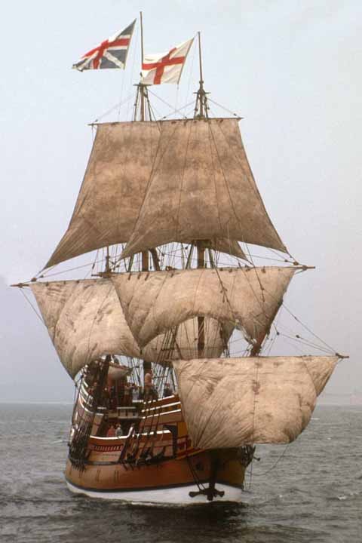
GOD’S PEOPLE FINDING GOD’S HEART FOR THE WORLD
PART 1: CONNECT WITH THE LOST
Famous Missions
1620
The Mayflower

Slide 12
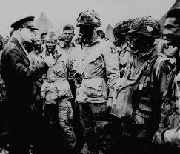
GOD’S PEOPLE FINDING GOD’S HEART FOR THE WORLD
PART 1: CONNECT WITH THE LOST
Famous Missions
1944
D-Day

Slide 13
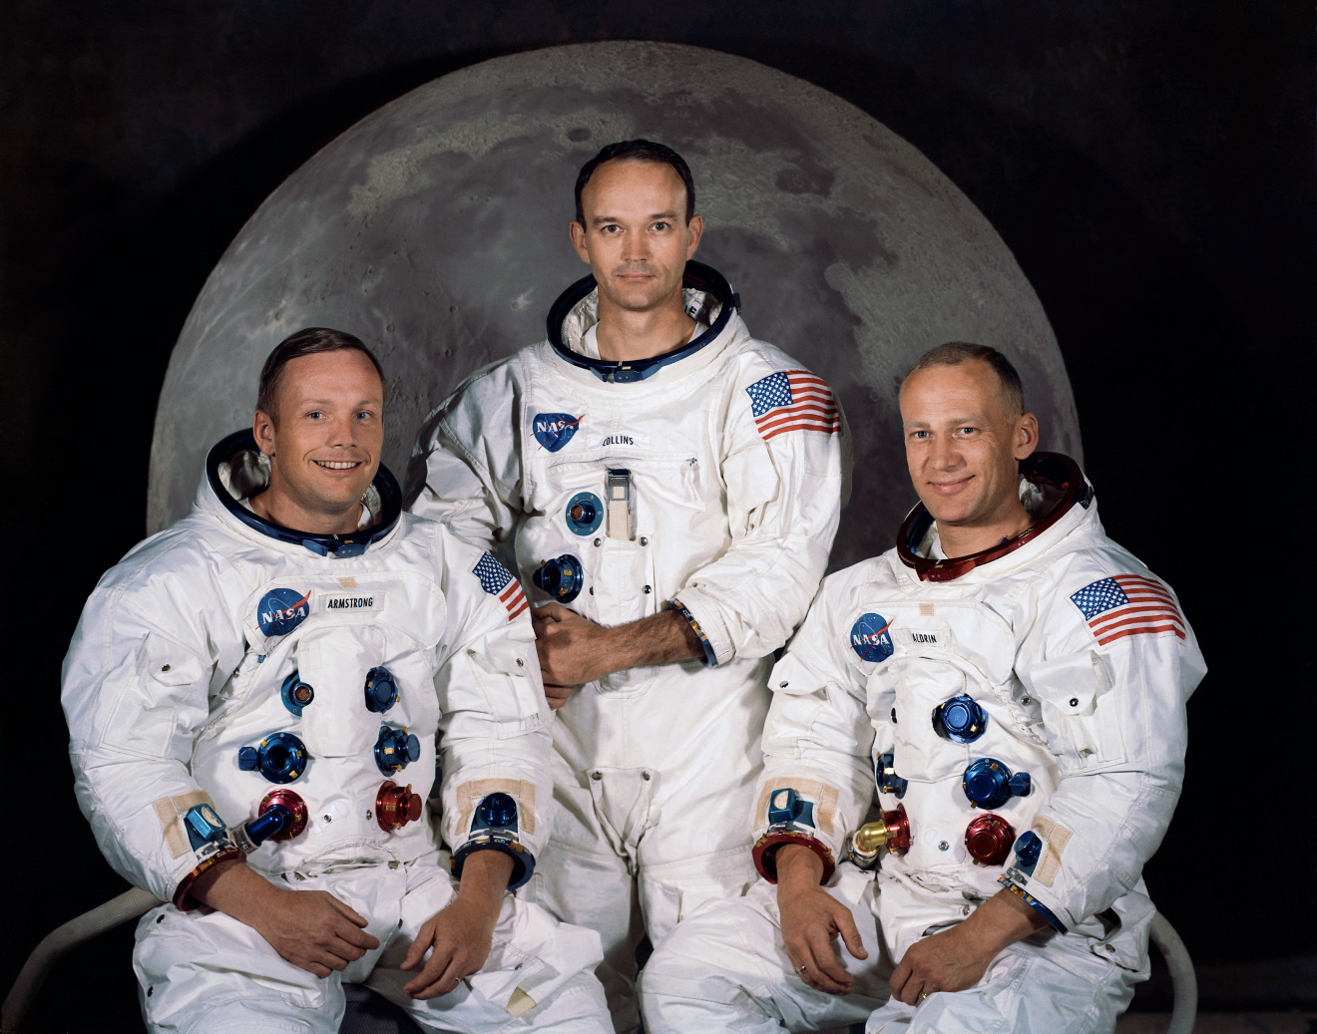
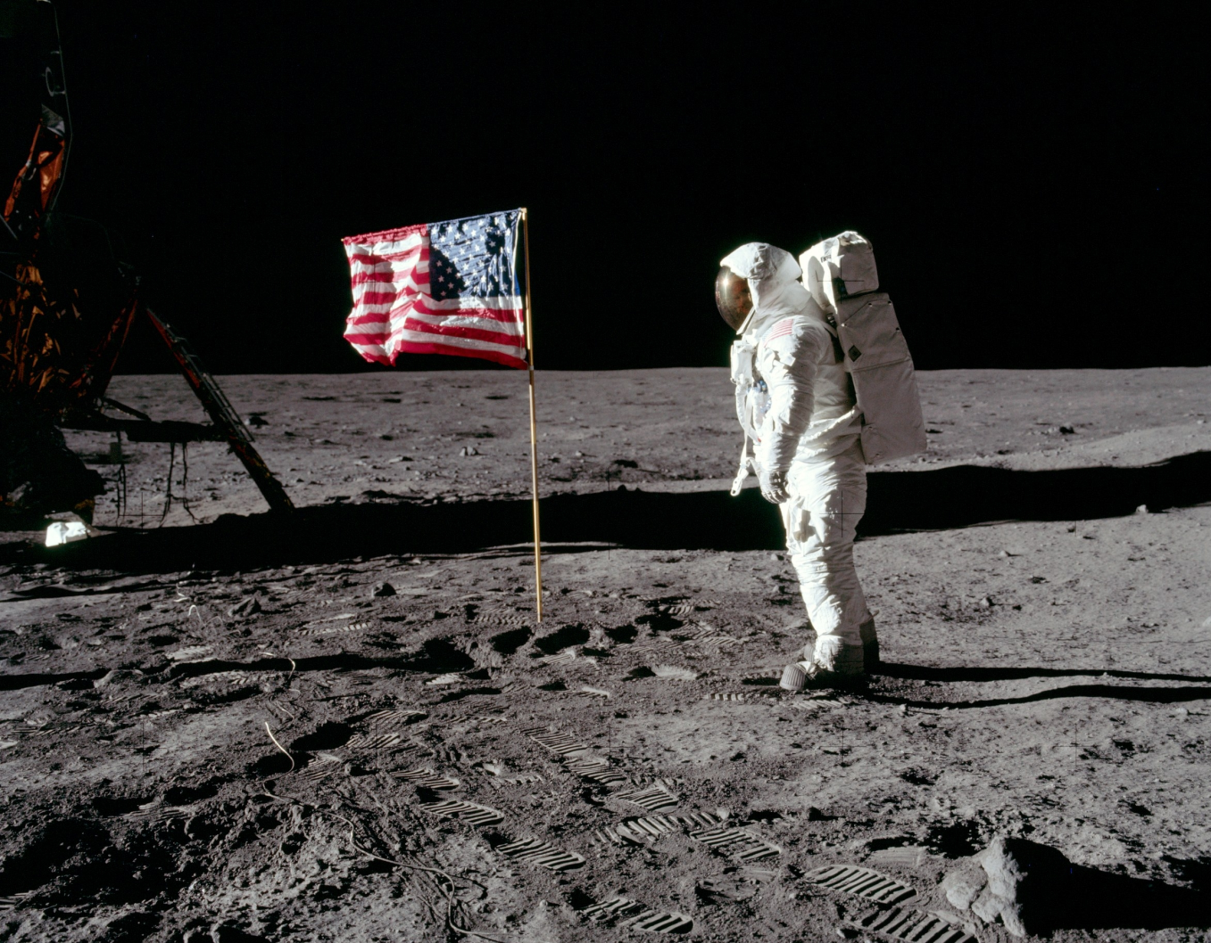
GOD’S PEOPLE FINDING GOD’S HEART FOR THE WORLD
PART 1: CONNECT WITH THE LOST
Famous Missions

Slide 14
We all have a Life Mission We all have a need to be connected.
Connect = build a relationship.
Relational Priorities
Connect with the Lord.
Connect with my Spouse.
Connect with my Family.
Connect with my Church.
Connect with the Lost. Pick one person!
Connecting is My Mission!
I need to connect with the Lost!
GOD’S PEOPLE FINDING GOD’S HEART FOR THE WORLD
PART 1: CONNECT WITH THE LOST

Slide 15
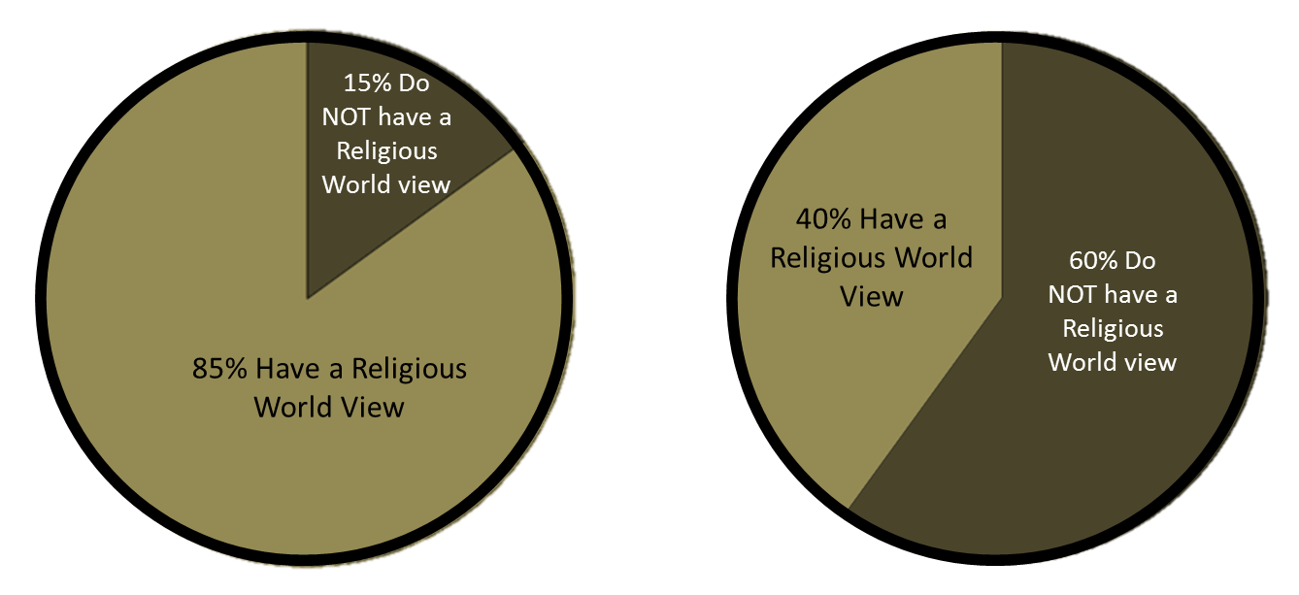
1. My Mission Need:
GOD’S PEOPLE FINDING GOD’S HEART FOR THE WORLD
PART 1: CONNECT WITH THE LOST

Slide 16
2. My Mission Statement (Acts 1)
3. My Mission Modeled
Luke 19:1-10
Matthew 9:9-12
GOD’S PEOPLE FINDING GOD’S HEART FOR THE WORLD
PART 1: CONNECT WITH THE LOST

