Slide 1
Learning what it means to be a disciple of Jesus

Slide 2
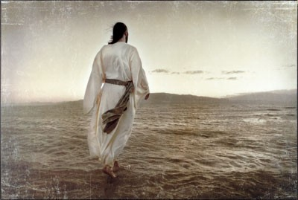
COME FOLLOW ME Learning what it means to be a disciple of Jesus
A dis●ci●ple: A follower
How do I become a Disciple? It starts at your salvation.
A Disciple of Jesus is disciplined.

Slide 3
COME FOLLOW ME Learning what it means to be a disciple of Jesus
It’s Time for a Strong Finish! (2 Tim. 4: 6-8)
Paul’s Keys to a Strong Finish in Life:
Live in the Present. (v. 6)
a. Am I reproducing myself?
b. Am I offering my life to God?
c. Am I ready for my departure?

Slide 4
COME FOLLOW ME Learning what it means to be a disciple of Jesus
Reflect on the Past. (v. 7)
Was I involved in the struggle for Christ?
Could the Lord depend on me?
Did I guard the truth of the gospel?

Slide 5
COME FOLLOW ME Learning what it means to be a disciple of Jesus
3. Look forward to the Future. (v. 8)
Am I excited to meet Jesus?
Am I living in view of that day?

