Slide 1
God's BIG Plan
God’s BIG Plan was for:
A People. (Who would birth the Messiah)
A Place. (Where many could be reached)
3. A Promise. (For anyone who wants salvation.)
A New Sermon Series at

Slide 2
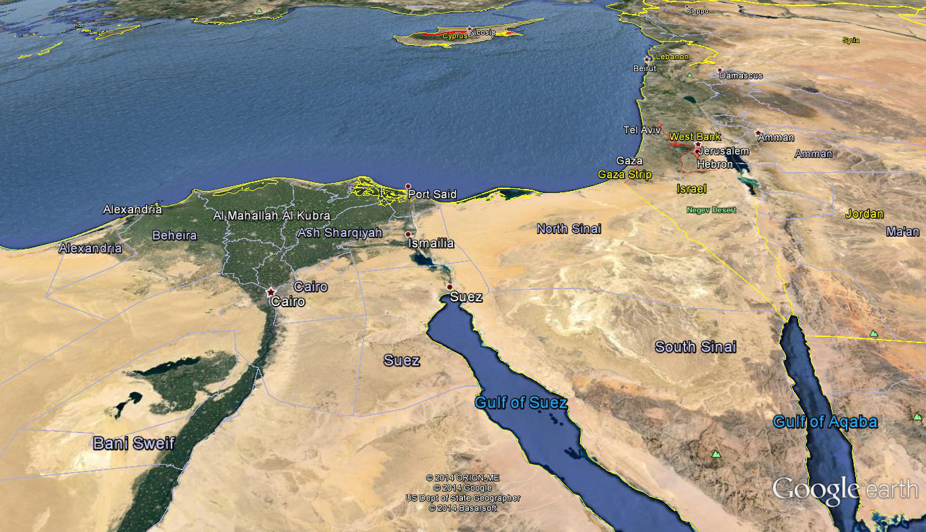
TODAY: Moses the Deliverer
MIDIAN

Slide 3
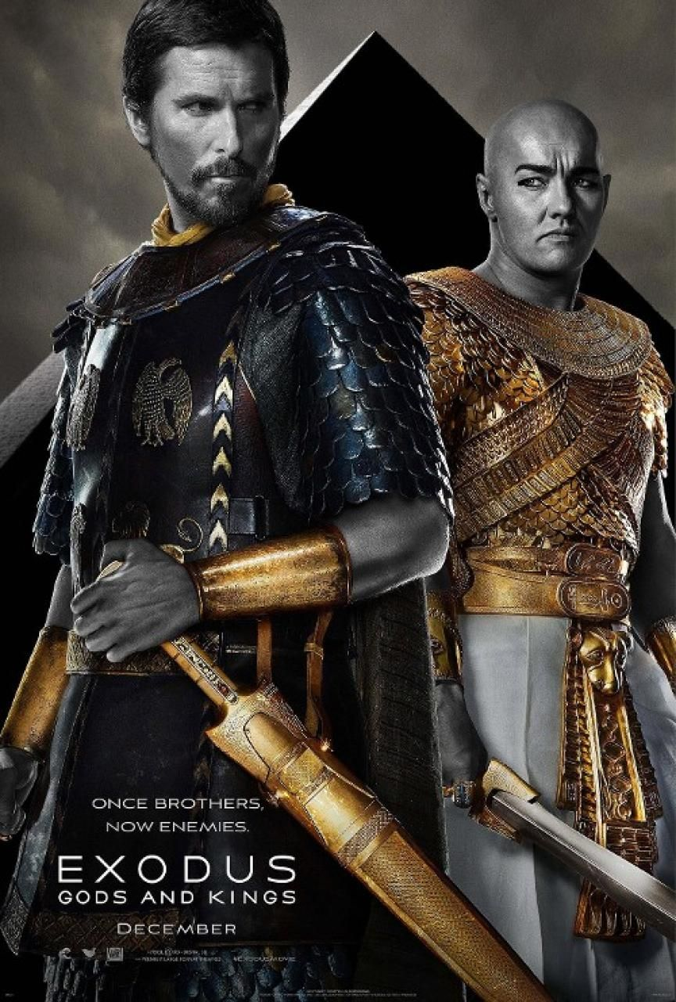
God's BIG Plan
A New Sermon Series at

Slide 4
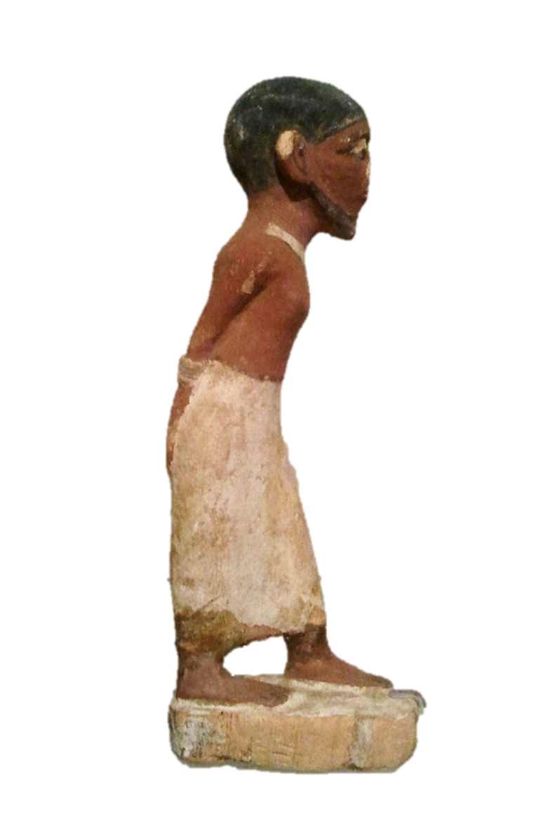
TODAY: Moses the Deliverer
Exodus Chapter 1
• The year is about BC. (SEE I Kings 6:2)
• years have passed since the time of Joseph.
• Israel is now by Egypt.
1526
350
Enslaved
MIDIAN

Slide 5
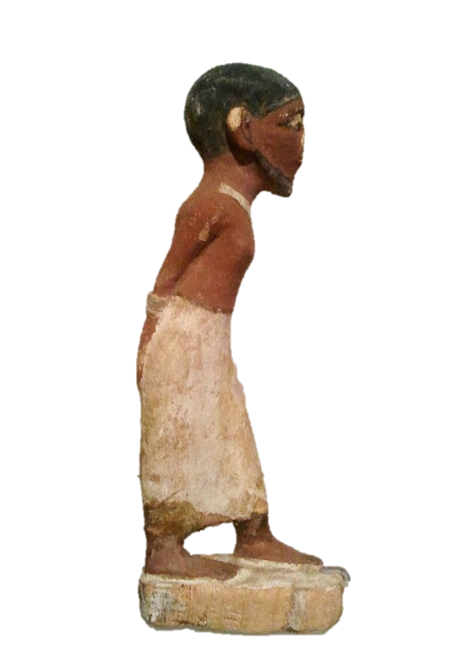
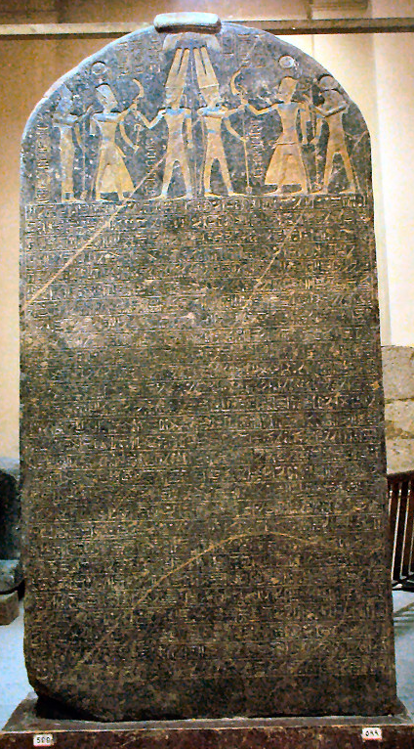
Egyptian reference to “Israelites”
By Ancient Egyptian Pharoah Merneptah (Reign: 1213 to 1203 BC)

Slide 6
TODAY: Moses the Deliverer
Exodus Chapter 2
•Moses is born into the tribe of .
•Moses flees Egypt and settles in Midian.
•The Lord the suffering of His people.
•The Lord has not His covenant.
Levi
hears
forgotten
MIDIAN

Slide 7
TODAY: Moses the Deliverer
Exodus Chapter 3
God said…
1.He would use Moses to His people.
2. “I will certainly you”.
3. His name is . .
4. His & would be seen by all.
deliver
Be with
I am
Name
Power
MIDIAN

Slide 8
God's BIG Plan
A New Sermon Series at

