Slide 1
Learning what it means to be a disciple of Jesus

Slide 2
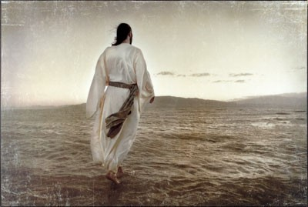
COME FOLLOW ME Learning what it means to be a disciple of Jesus
A dis●ci●ple: A follower
How do I become a Disciple? It starts at your salvation.
A Disciple of Jesus is disciplined.

Slide 3
COME FOLLOW ME Learning what it means to be a disciple of Jesus
Today’s Sermon: It’s Time to Get Serious!
2 Timothy 4:1-5
1. IT’S TIME FOR SERIOUS PREACHING. (4:1-2)
Why? Because Jesus is coming soon. (v.1)
What? Preach the Word. (v.2)
When? Every chance you get. (v.2)
How? With application to life. (v.2)

Slide 4
COME FOLLOW ME Learning what it means to be a disciple of Jesus
IT’S TIME FOR SERIOUS HEARING. (4:3-4)
Why? So I won’t turn away. (v.3)
What? It takes endurance. (v.3)
When? You’re hearing what you need to hear. (v.3)
How? By comparing the spoken word to the written Word. (v.4)

Slide 5
COME FOLLOW ME Learning what it means to be a disciple of Jesus
3. IT’S TIME FOR SERIOUS DOING. (4:5)
Be Sober.
Endure Hardship.
Do the work of an evangelist.
Fulfill your ministry!

Slide 6
COME FOLLOW ME Learning what it means to be a disciple of Jesus

