Slide 1
The Harvest Strategy- How we fulfill our purpose!
We Apply God’s Word
Part 5 in “The Harvest Strategy” Series

Slide 2
The Harvest Strategy- How we fulfill our purpose!
We Apply God’s Word
Part 5 in “The Harvest Strategy” Series
James 1:22 “But prove yourselves doers of the word, and not merely hearers who delude themselves.”

Slide 3
The Harvest Strategy- How we fulfill our purpose!
We Apply God’s Word
Part 5 in “The Harvest Strategy” Series
Charles Spurgeon on vows: “I have found in my own spiritual life, that the more rules I lay down for myself, the more sins I commit. The habit of regular morning and evening prayer is one which is indispensible to a believer’s life, but the prescribing of the length of prayer, and the constrained remembrance of so many persons and subjects, may gender unto bondage, and strangle prayer rather than assist it. To say I will humble myself at such a time, and rejoice at such another season, is nearly as much an affectation as when the preacher wrote in the margin of his sermon, “Cry here,” “Smile here.” Why, if the man preached from his heart, he would be sure to cry in the right place, and to smile at a suitable moment; and when the spiritual life is sound, it produces prayer at the right time, and humiliation of soul and sacred joy spring forth spontaneously, apart from rules and vows.

Slide 4
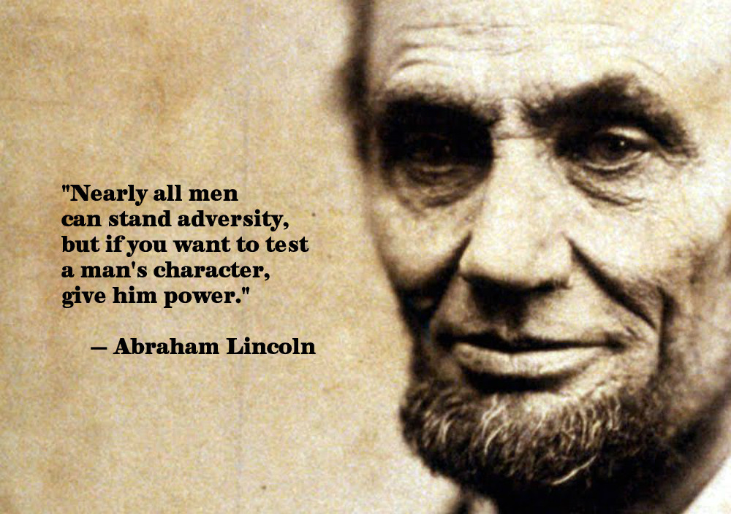
The Harvest Strategy- How we fulfill our purpose!
We Apply God’s Word
Part 5 in “The Harvest Strategy” Series
Nehemiah 9:39-10:39
Personal Application of God’s Word:
1. __________________________ (9:38-10:27)
By setting the right example.
By doing what they ask of others.
By not being a hypocrite.
BEGINS WITH LEADERSHIP

Slide 5
The Harvest Strategy- How we fulfill our purpose!
We Apply God’s Word
Part 5 in “The Harvest Strategy” Series
Nehemiah 9:39-10:39
Personal Application of God’s Word:
2. ____________________________________ (10:28-29)
Find your group.
Obey all of God’s word.
Separate, don't sever (John 17:14-17)
REQUIRES MY PERSONAL COMMITMENT

Slide 6
The Harvest Strategy- How we fulfill our purpose!
We Apply God’s Word
Part 5 in “The Harvest Strategy” Series
Nehemiah 9:39-10:39
Personal Application of God’s Word:
3. ____________________________ (10:30)
Parents- PRAY, GUIDE, MONITOR!
MUST EXTEND TO THE HOME

Slide 7
The Harvest Strategy- How we fulfill our purpose!
We Apply God’s Word
Part 5 in “The Harvest Strategy” Series
Nehemiah 9:39-10:39
Personal Application of God’s Word:
4. _________________________ (10:31)
Our business practices (work) should reflect our Christian commitment, even if it's costly or inconvenient.
MUST EXTEND TO WORK

Slide 8
The Harvest Strategy- How we fulfill our purpose!
We Apply God’s Word
Part 5 in “The Harvest Strategy” Series
Nehemiah 9:39-10:39
Personal Application of God’s Word:
______________________________ (10:32-39)
Support the needs of your church.
Realize He owns it all! We are the managers.
Give in proportion to God’s prospering (I Cor. 16:2)
Our giving should be planned & systematic (1 Cor. 16:2)
Give cheerfully. (I Cor. 9:7)
Demonstrate that God has first place in your heart. (Matt 6:21, 24)
MUST EXTEND TO CHURCH

Slide 9
The Harvest Strategy- How we fulfill our purpose!
We Apply God’s Word
Part 5 in “The Harvest Strategy” Series
Nehemiah 9:39-10:39
Personal Application of God’s Word:
SUMMARY: Apply God’s Word personally and specifically.

